Slide 1
Phase 3 Test Report

Slide 2
测试内容
SV Sim vs VXT-II test result
SISO | Cable Test |  | OTA Test
Tx (100MHz) | EVM ACLR SEM 单个RFImp的测量 组合RFImp的测量 |  | EVM ACLR SEM Ideal情况的测量 组合RFImp的测量
Rx (100MHz) | Sensitivity(wide range) | EVM Throughput 单个RFImp的测量 组合RFImp的测量 | EVM Throughput Ideal情况的测量 组合RFImp的测量
 | Narrow Blocking
 | General Blocking
 | Intermodulation
PA_TOI
DAC_Nbits
Gain Imbalance
IQ offset
Phase Noise
Noise Figure
ADC_Nbits
Gain Imbalance
IQ offset
Phase Noise

Slide 3
SV结合VXT-II 发射端指标测试验证流程图
SV产生5G NR基站 SISO理想基带信号
带入Tx射频器件非理想因素
下载到VXT-||原型机
OTA需带入用户天线
OTA需要经过暗室
OTA测试需经过暗室接收天线
VXT-|| 原型机收端接收
VSA将信号送回到SystemVue
测量基站发射端指标
带入Tx射频非理想因素
Phase Noise
Oscillator
Oscillator
5G NR基站 SISO Ideal Signal
DAC
Modulator
filter
Mixer
Amplifier
DAC_Nbits
IQ offset
Gain Imbalance
PA_TOIout

Slide 4
纯软件仿真发射端流程图
SV产生5G NR基站 SISO理想基带信号
带入Tx射频器件非理想因素
带入VXT-|| Tx系统级参数
OTA需带入用户发射天线模型
OTA需要经过OTA模型
OTA需带入暗室接收天线模型
带入VXT-|| Rx系统级参数
仿真基站发射指标
带入系统参数仿真
VXT-II Phase Noise
Oscillator
5G NR基站 SISO Imp Signal
Modulator
Density
A to D
OTA
Gain
VXT-II IQ offset
VXT-II Gain Imbalance
天线方向图
Chamber Pathloss
VXT-II Noise Density
VXT-II ADC_Nbits

Slide 5
SV结合VXT-II 接收端指标测试验证流程图
SV产生5G NR基站 SISO理想基带信号
带入Rx射频器件非理想因素
下载到VXT-||原型机
OTA测试需带入暗室发射天线
OTA测试需要经过暗室
OTA测试需经过用户接收天线
VXT-|| 原型机收端接收
VSA将信号送回到SystemVue
测量基站接收端指标
带入Rx射频非理想因素
Phase Noise
Oscillator
Oscillator
5G NR基站 SISO Ideal Signal
Modulator
Noise Density
Amplifier
Mixer
Demod
ADC
174dBm/Hz
Noise Figure
Gain Imbalance
IQ offset
ADC_Nbits

Slide 6
纯软件仿真接收端流程图
SV产生5G NR基站 SISO理想基带信号
带入Rx射频器件非理想因素
带入VXT-|| Tx系统级参数
OTA需带入暗室发射天线模型
OTA需要经过OTA模型
OTA需带入用户接收天线模型
带入VXT-|| Rx系统级参数
仿真基站发射指标
带入系统参数仿真
VXT-II Phase Noise
Oscillator
5G NR基站 SISO Imp Signal
Modulator
Density
Demod
A to D
OTA
Gain
天线方向图
Chamber Pathloss
VXT-II
Ndensity
VXT-II Gain Imbalance
VXT-II IQ offset
VXT-II ADC_Nbits

Slide 7
NR DL SISO Tx EVM/ACLR vs PA_TOI
NR DL 100MHz SV Sim vs VXT-II Test
RF Imp | EVM(dB) |  |  | 1BW_Upper_ACLR(dB) |  |  | 1BW_Lower_ACLR(dB)
PA_TOI (dBm) | VXT | Sim | Delta | VXT | Sim | Delta | VXT | Sim | Delta
30 | -48.458 | -49.843 | 1.385 | 53.743 | 53.563 | 0.18 | 53.926 | 53.579 | 0.347
20 | -37.54 | -37.974 | 0.434 | 43.945 | 44.369 | 0.424 | 44.108 | 44.426 | 0.318
15 | -27.581 | -27.651 | 0.07 | 34.283 | 34.43 | 0.147 | 34.456 | 34.501 | 0.045
VXT-II NR Tx Cable Test Parameters
Power(dBm) | Ndensity(dBm/Hz) | DAC_Nbits(Bits) | Gain Imbalance(dB) | IQ Offset | Phase Noise(dBc/Hz)
0 | -133.9 | 14 | 0.002 | 0.0044 | [100, -97.133, 1000, -106.072, 1e4, -118.607]

Slide 8
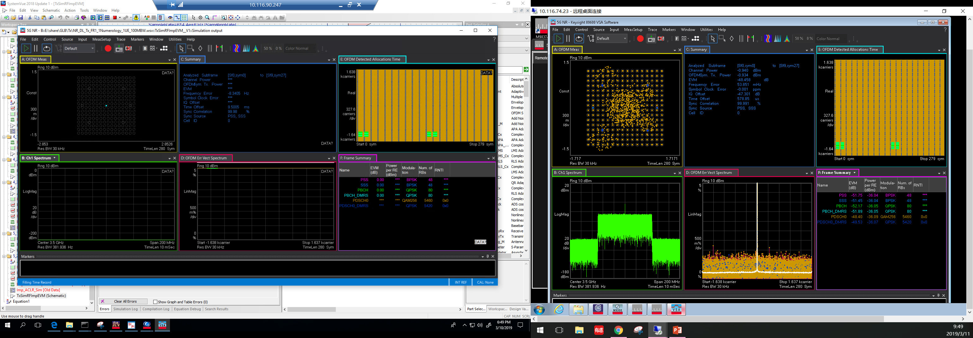
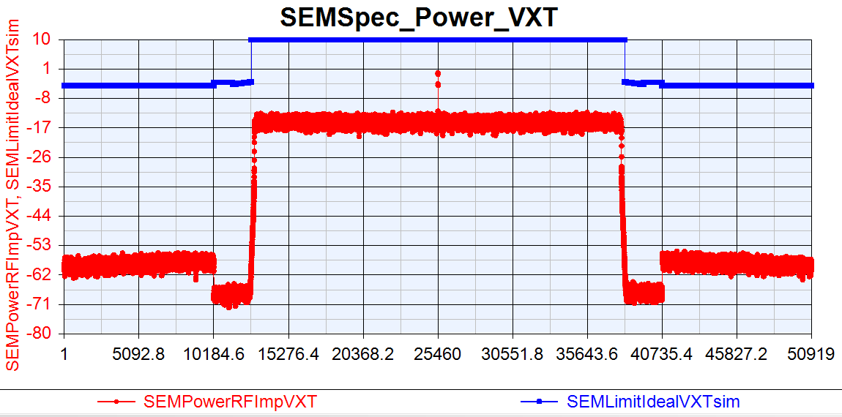
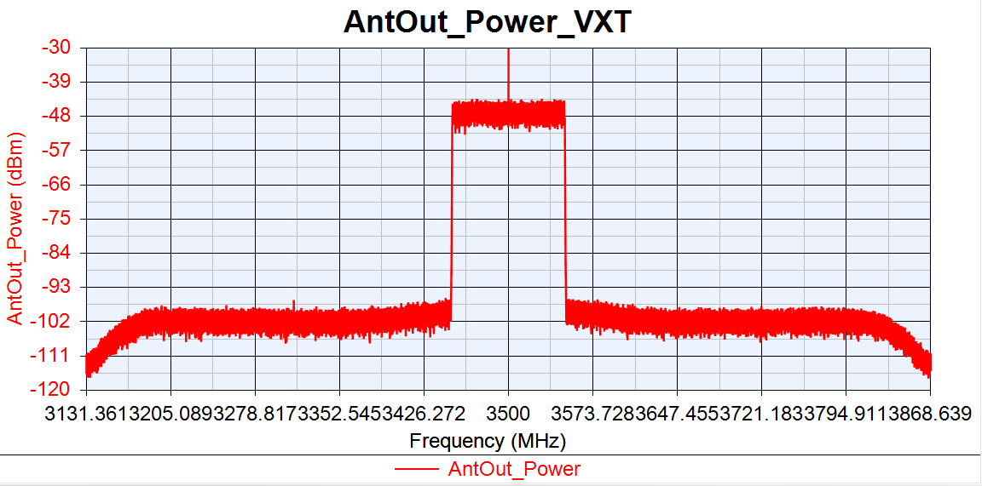
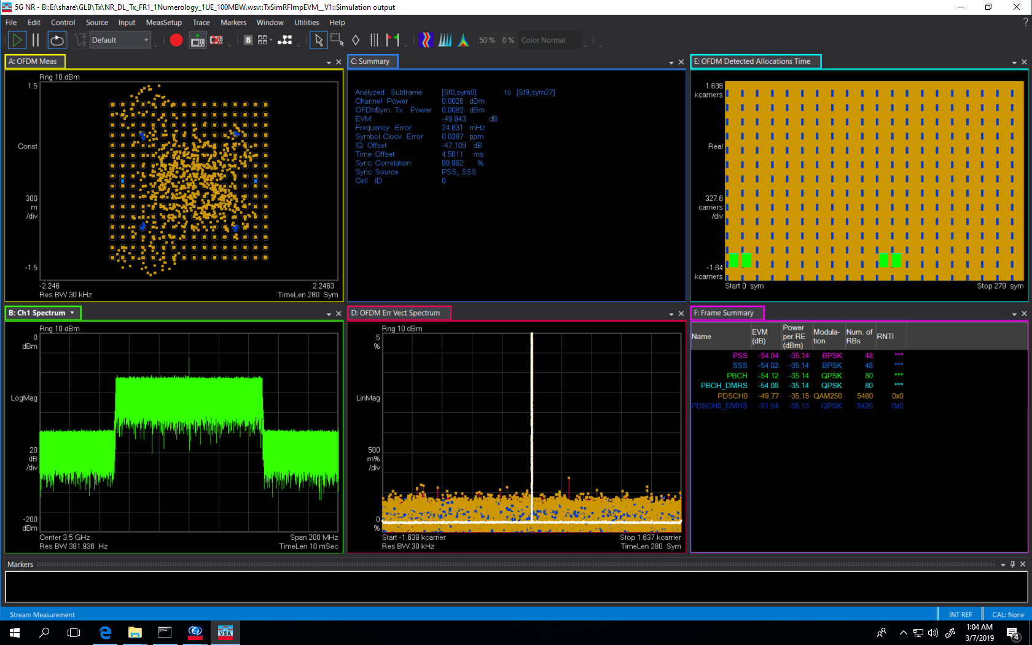

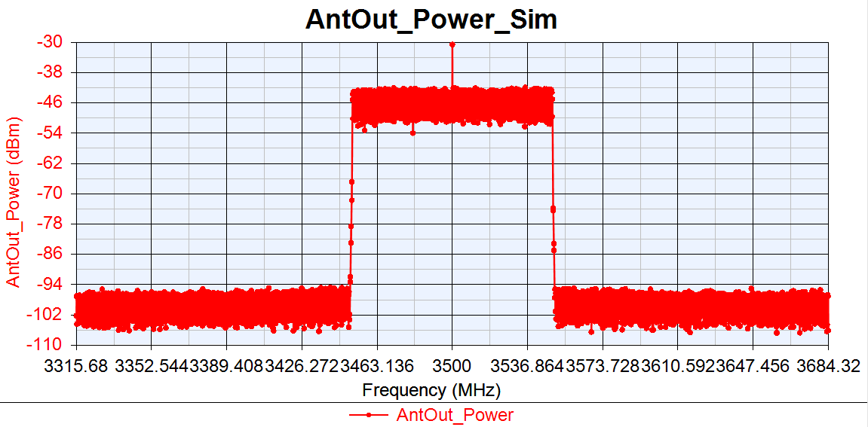
VXT-II vs SV Sim: PA_TOI=30dBm
NR DL 100MBW Tx Cable
VXT-II
EVM:-48.458dB
IQoffset:-47.301dB
EVM:-49.843dB
IQoffset:-47.106dB
Sim

Slide 9
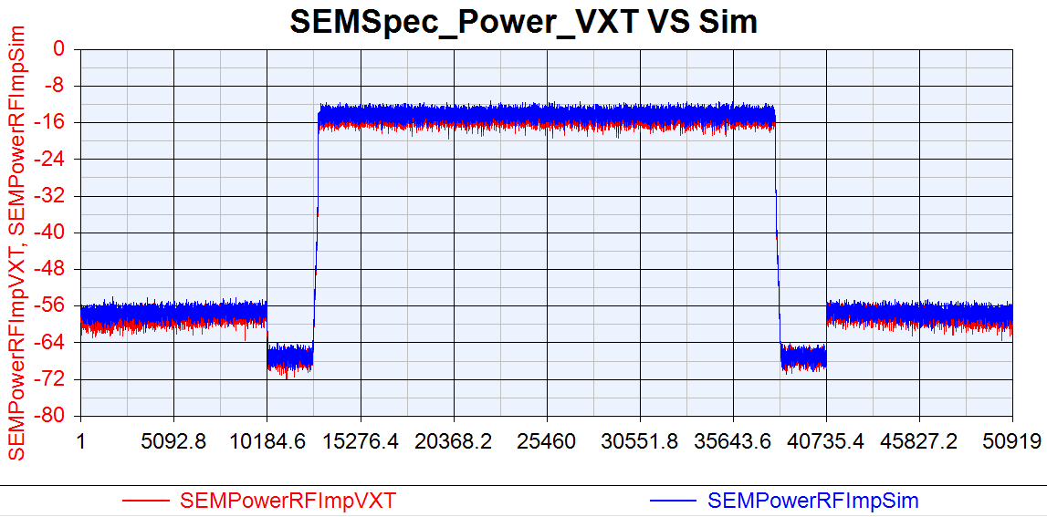
VXT SEM VS Sim SEM: PA_TOI=30dBm
NR DL 100MBW Tx Cable

Slide 10
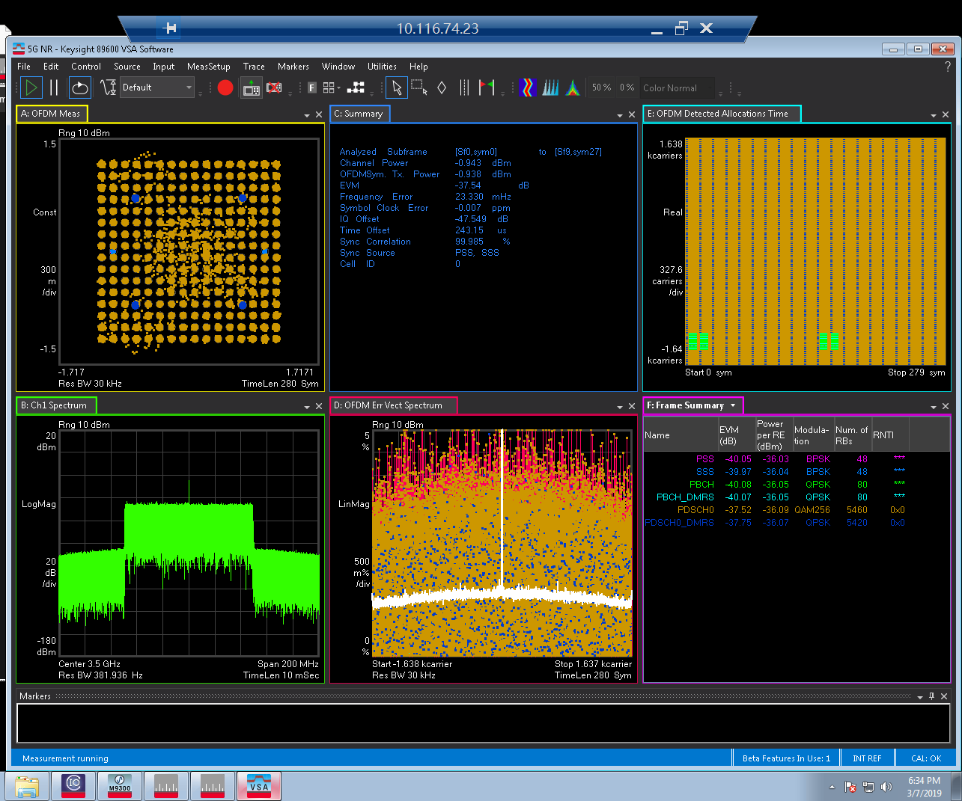
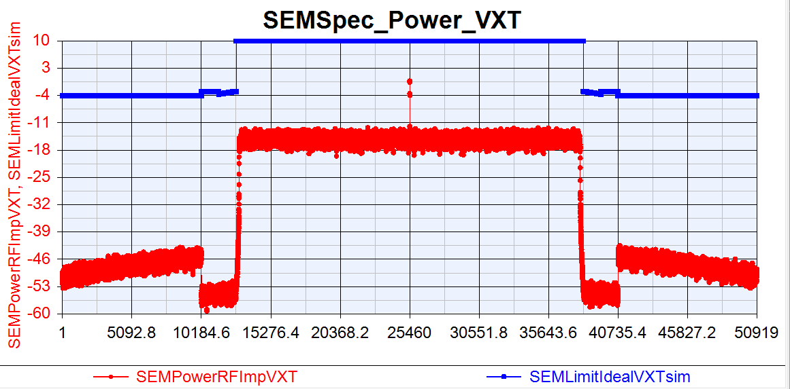
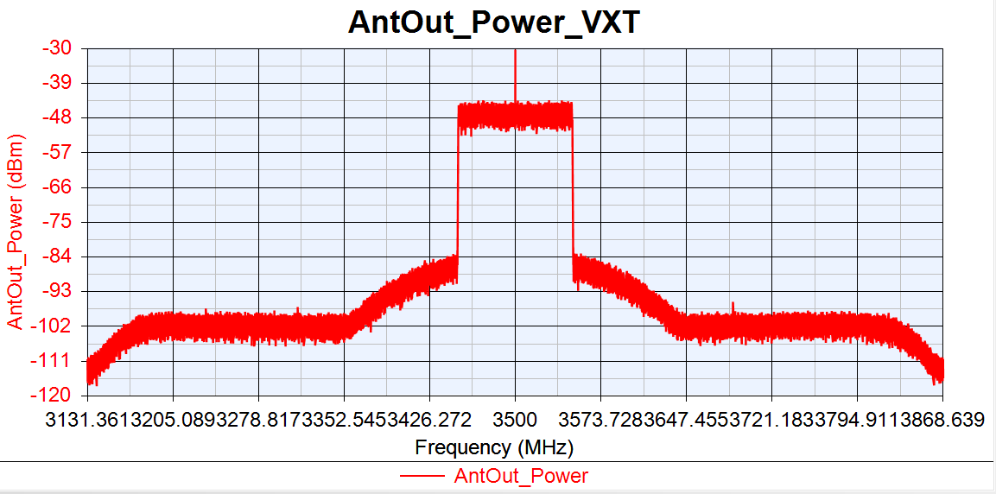
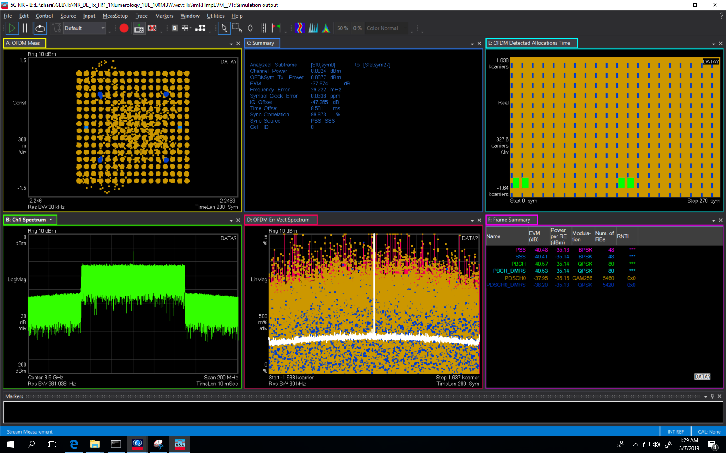
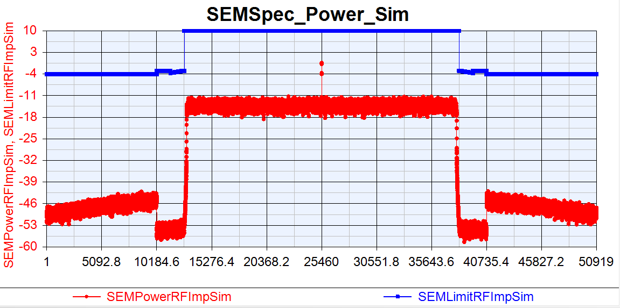
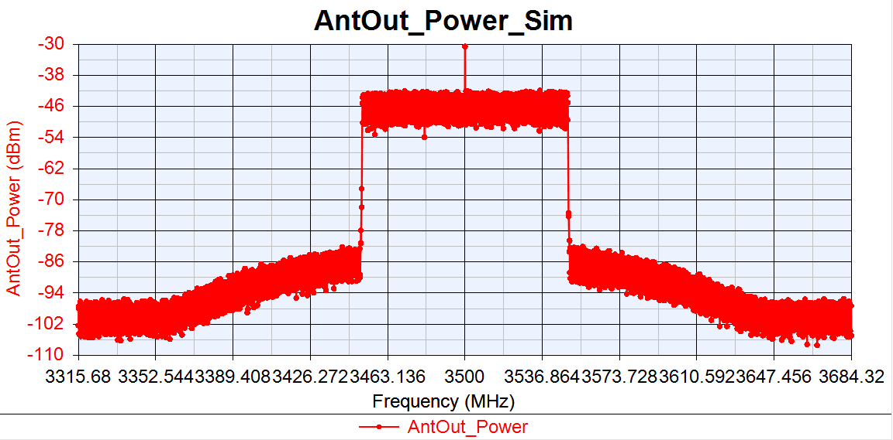
VXT-II vs SV Sim: PA_TOI=20dBm
NR DL 100MBW Tx Cable
VXT-II
EVM:-37.54dB
IQoffset:-47.549dB
EVM:-37.974dB
IQoffset:-47.265dB
Sim

Slide 11
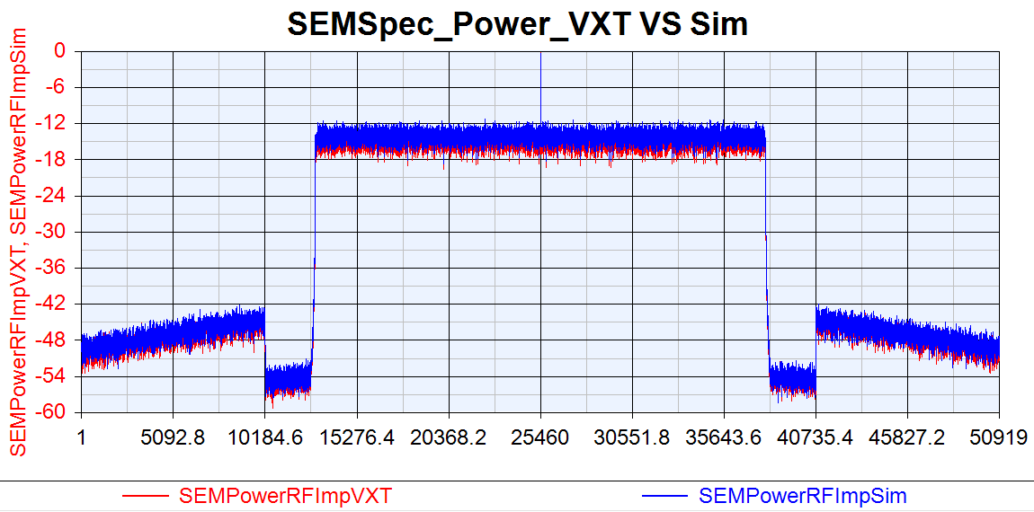
VXT SEM VS Sim SEM: PA_TOI=20dBm
NR DL 100MBW Tx Cable

Slide 12
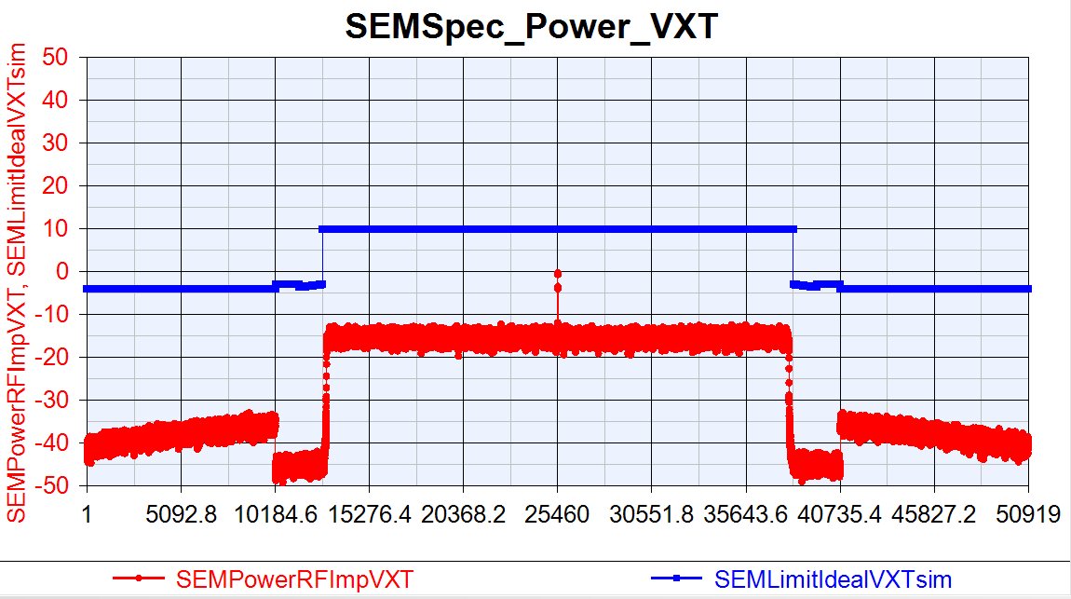
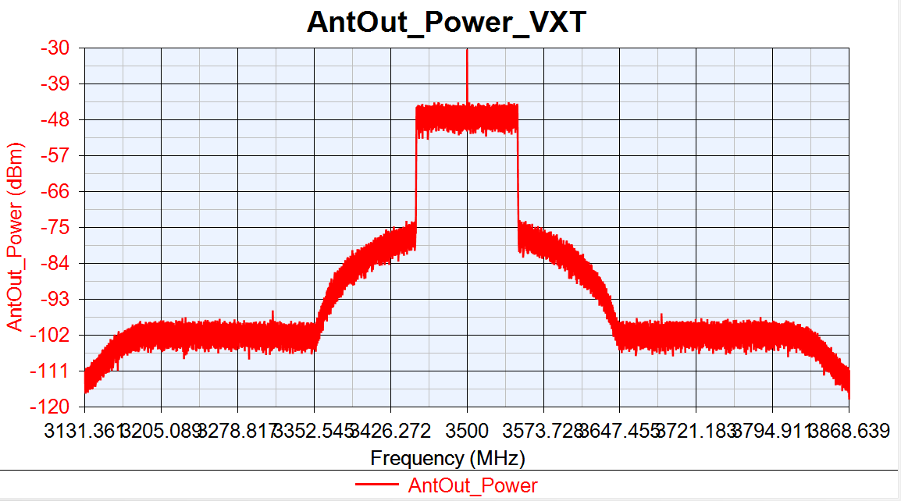
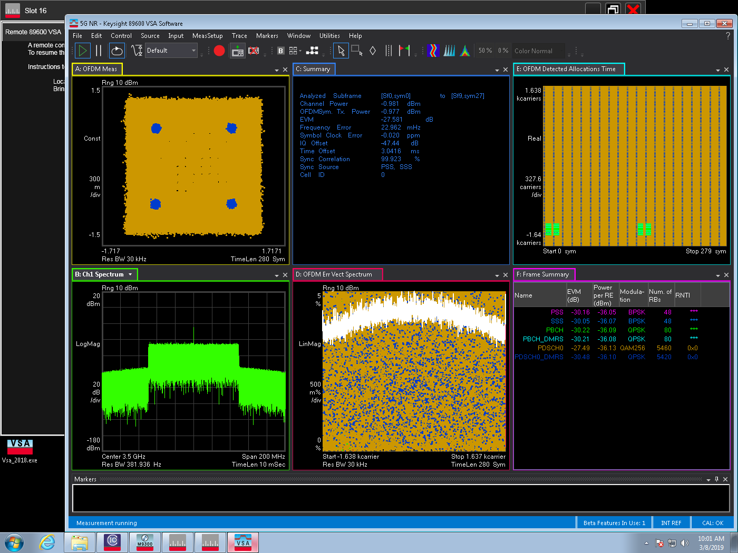
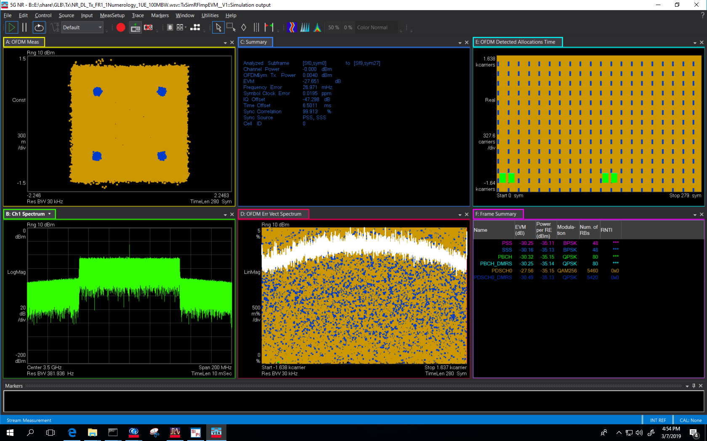
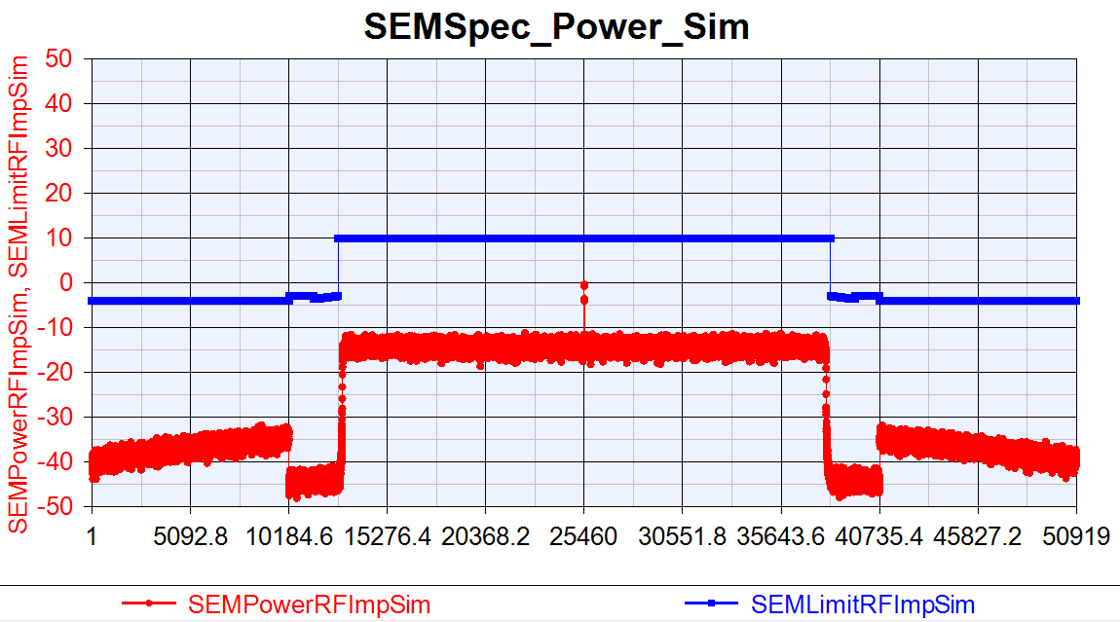
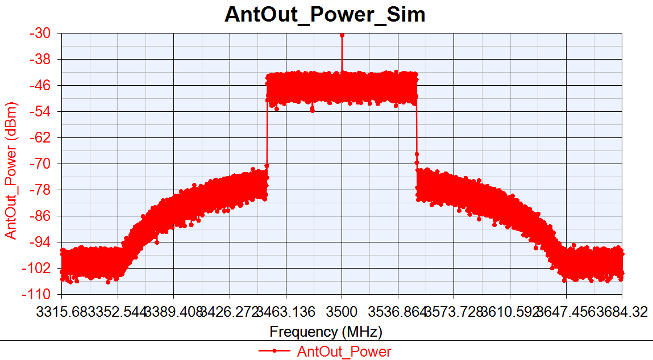
VXT-II vs SV Sim: PA_TOI=15dBm
NR DL 100MBW Tx Cable
VXT-II
EVM:-27.581dB
IQoffset:-47.44dB
EVM:-27.651dB
IQoffset:-47.298dB
Sim

Slide 13
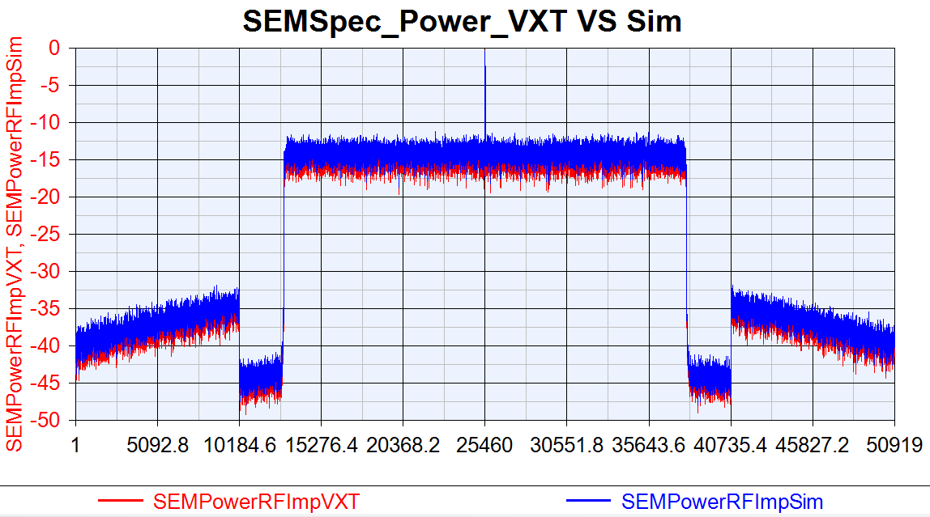
VXT SEM VS Sim SEM: PA_TOI=15dBm
NR DL 100MBW Tx Cable

Slide 14
NR DL SISO Tx EVM/ACLR vs Phase Noise
NR DL 100MHz SV Sim vs VXT-II Test
RF Imp | EVM(dB) |  |  | 1BW_Upper_ACLR |  |  | 1BW_Lower_ACLR
Phase Noise (dBc/Hz) | VXT | Sim | Delta | VXT | Sim | Delta | VXT | Sim | Delta
-10dB | -48.27 | -49.823 | 1.553 | 53.883 | 53.565 | 0.318 | 54.132 | 53.559 | 0.573
-15dB | -48.256 | -48.869 | 0.613 | 53.869 | 53.551 | 0.318 | 54.118 | 53.568 | 0.55
-35dB | -44.057 | -44.852 | 0.795 | 54.041 | 53.543 | 0.502 | 54.316 | 53.567 | 0.749
-40dB | -32.341 | -32.389 | 0.047 | 54.069 | 53.529 | 0.48 | 54.367 | 53.581 | 0.786
VXT-II NR Tx Cable Test Parameters
Power(dBm) | Ndensity(dBm/Hz) | DAC_Nbits(Bits) | Gain Imbalance(dB) | IQ Offset | PA_TOI(dBm)
0 | -133.9 | 14 | 0.002 | 0.0044 | 30

Slide 15
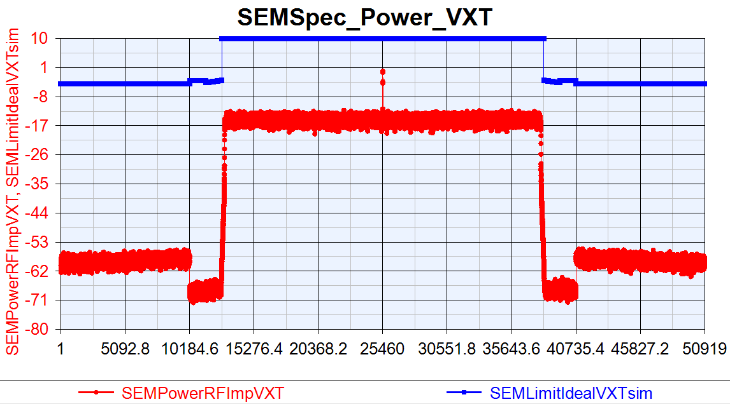
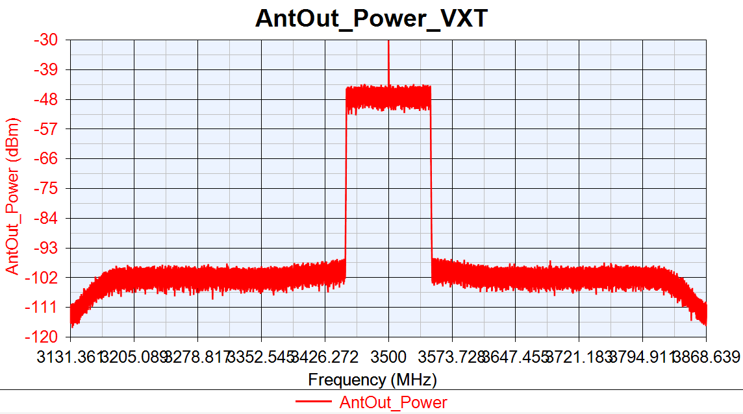
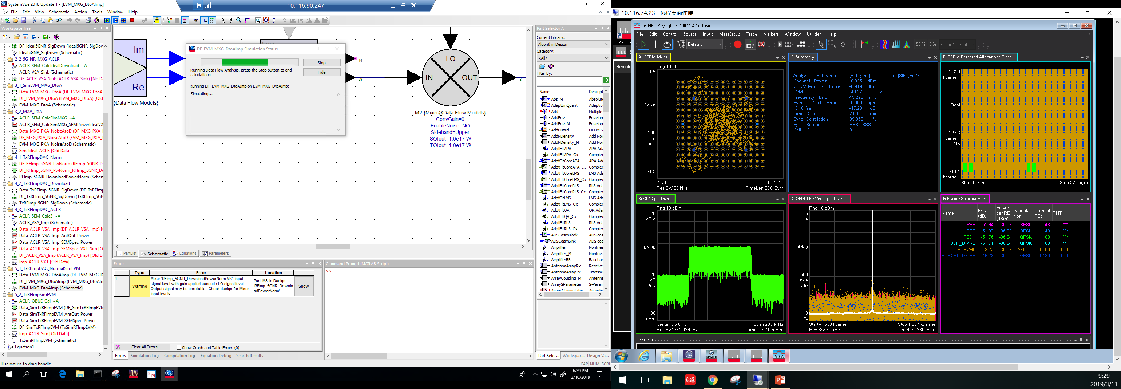
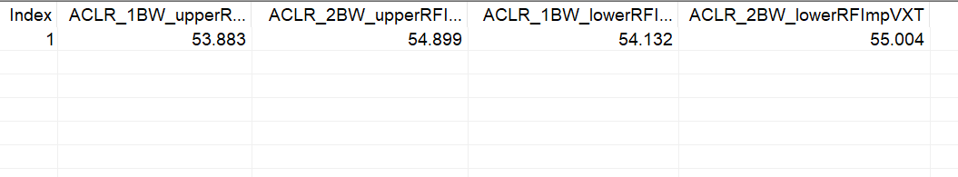
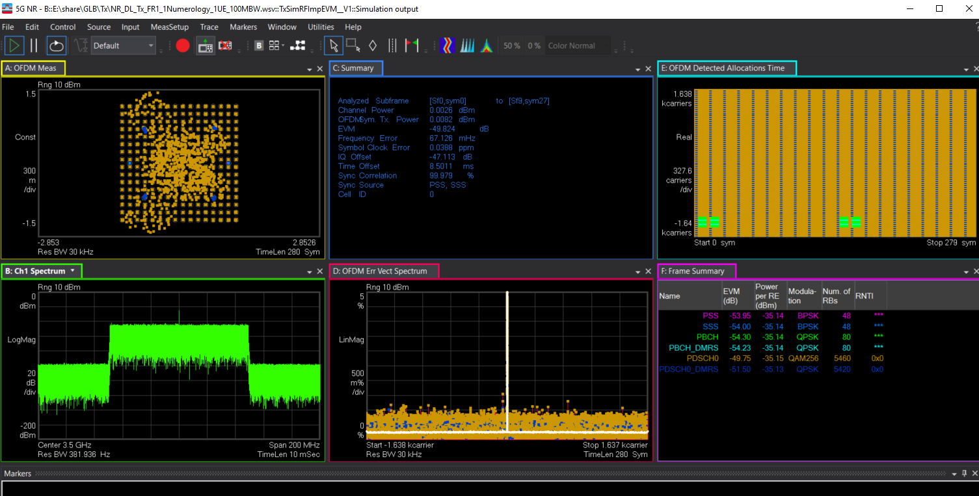

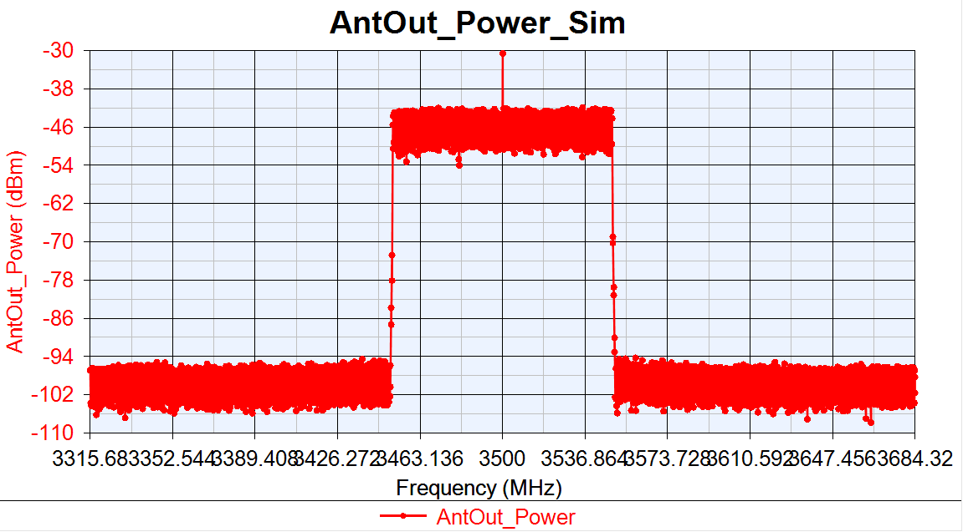
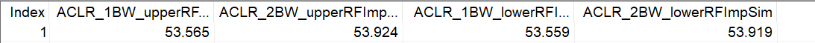
VXT-II vs SV Sim: PhaseNoise =[100, -87.133, 1000, -96.072, 1e5, -108.607]
NR DL 100MBW Tx Cable
VXT-II
EVM:-48.27dB
IQoffset:-47.23dB
EVM:-49.824dB
IQoffset:-47.113dB
Sim

Slide 16
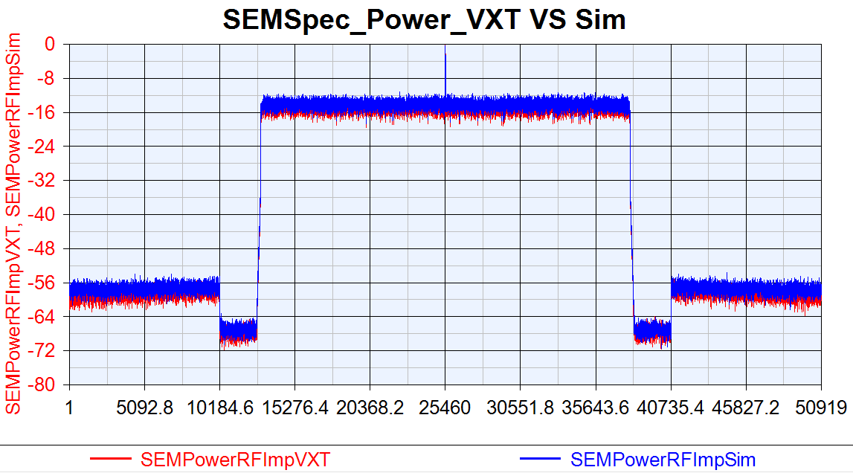
VXT SEM vs SV SEM: PhaseNoise =[100, -87.133, 1000, -96.072, 1e5, -108.607]
NR DL 100MBW Tx Cable

Slide 17
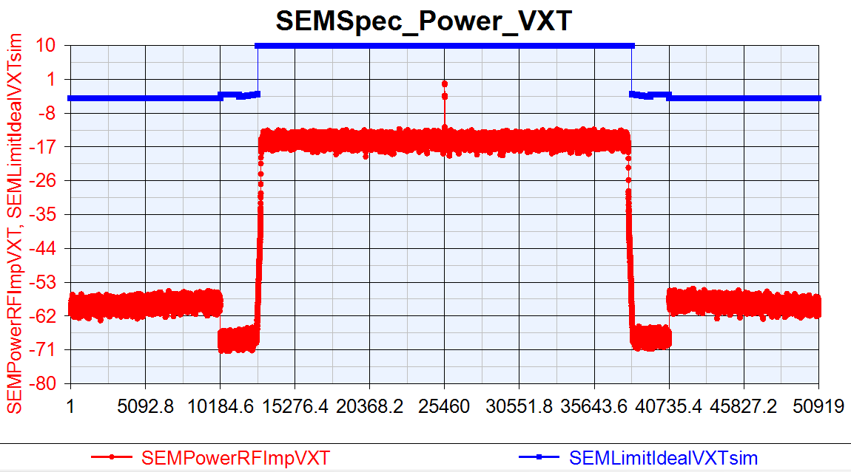
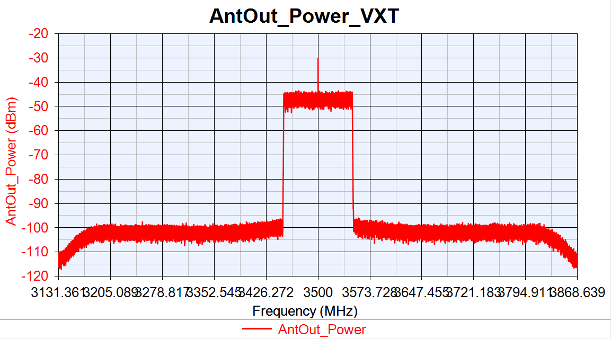
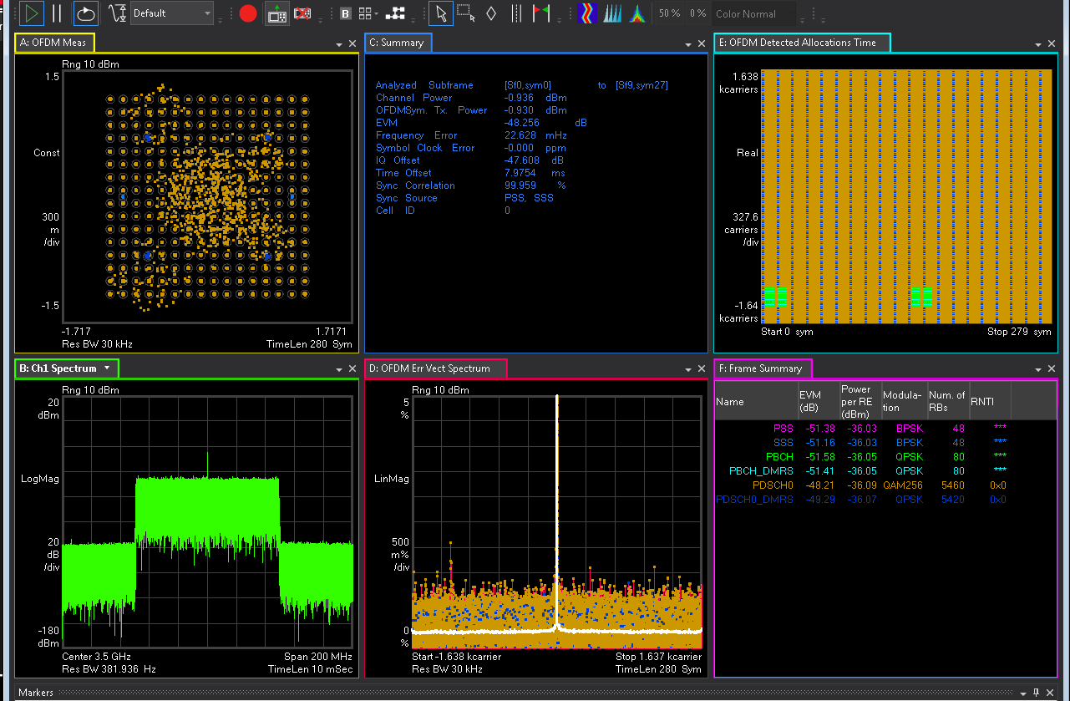
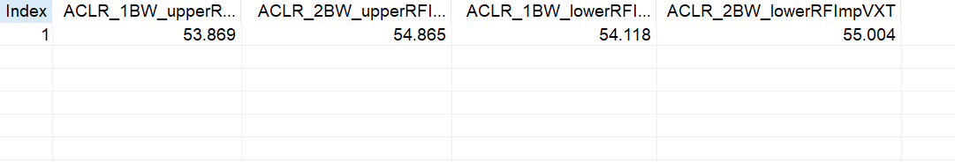

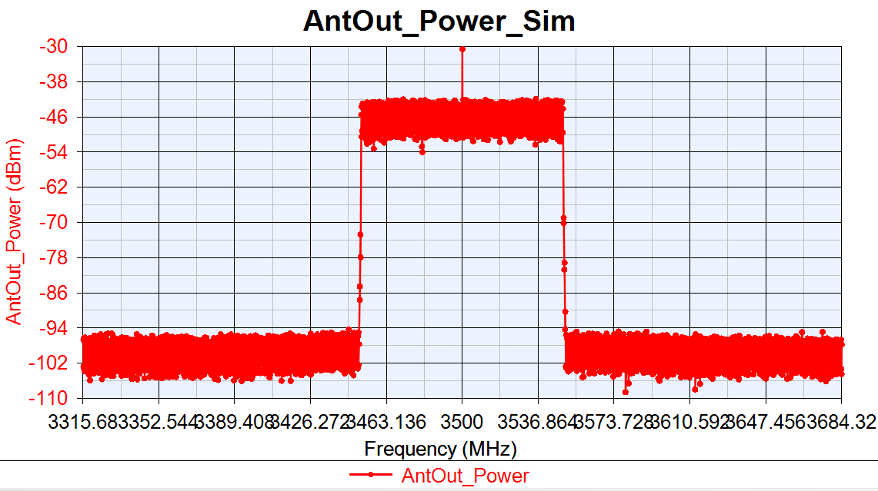
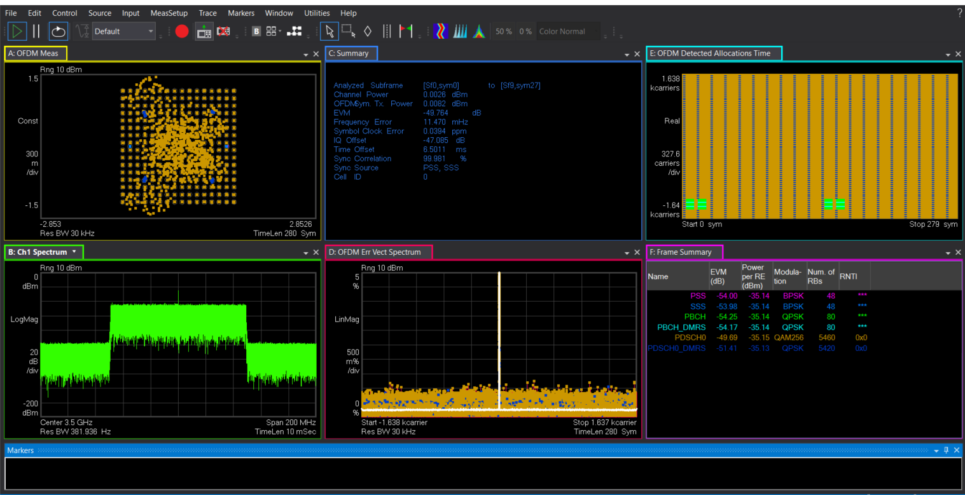
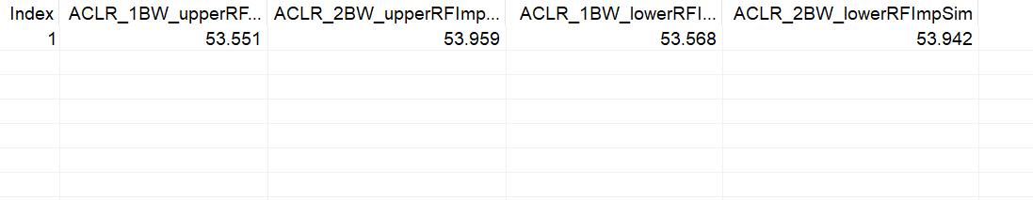
VXT-II vs SV Sim: PhaseNoise =[100, -82.133, 1000, -91.072, 1e5, -103.607]
NR DL 100MBW Tx Cable
VXT-II
EVM:-48.256dB
IQoffset:-47.608dB
EVM:-48.764dB
IQoffset:-47.085dB
Sim

Slide 18
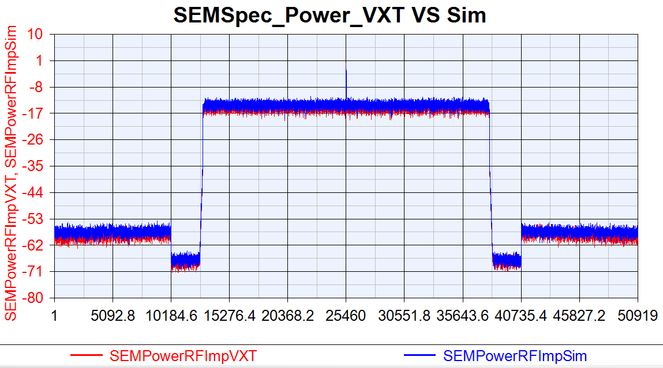
VXT SEM vs SV SEM: PhaseNoise =[100, -82.133, 1000, -91.072, 1e5, -103.607]
NR DL 100MBW Tx Cable

Slide 19
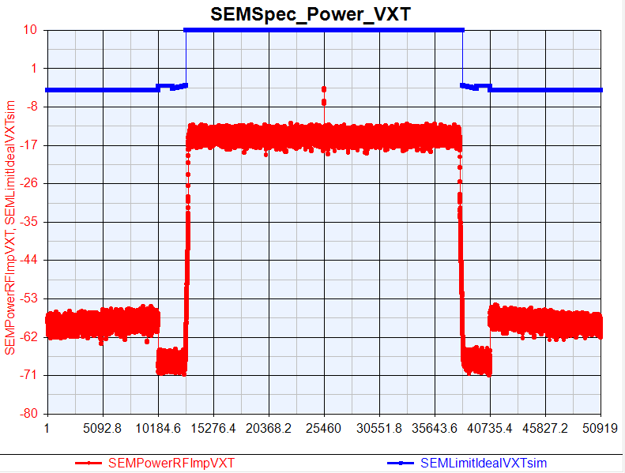
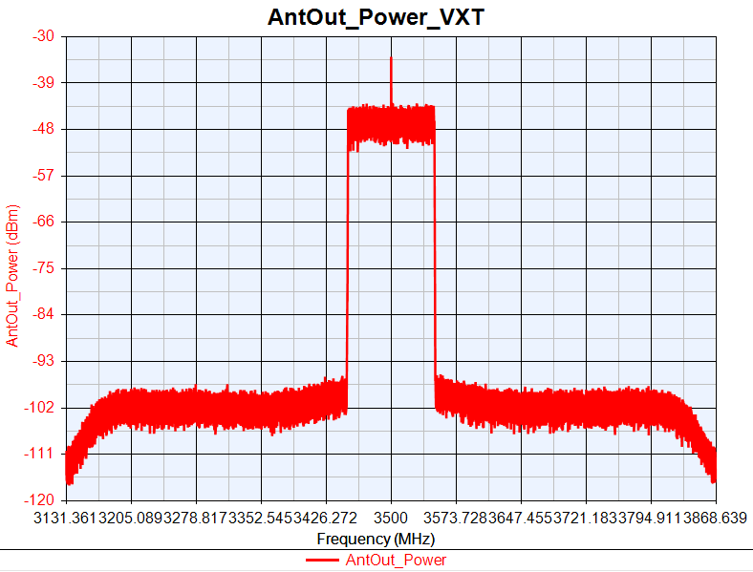
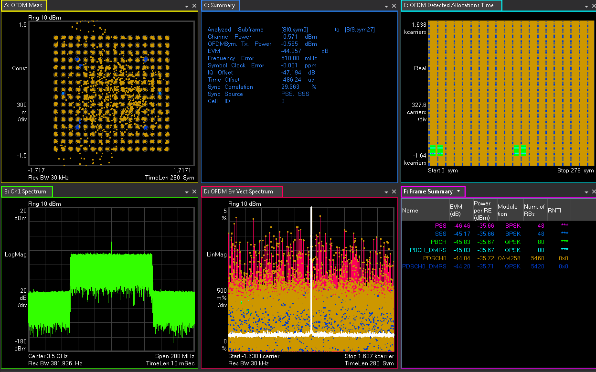
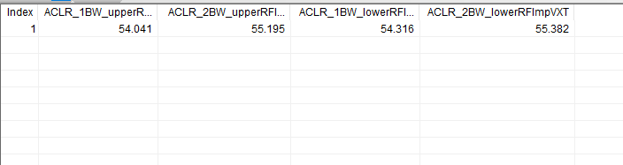
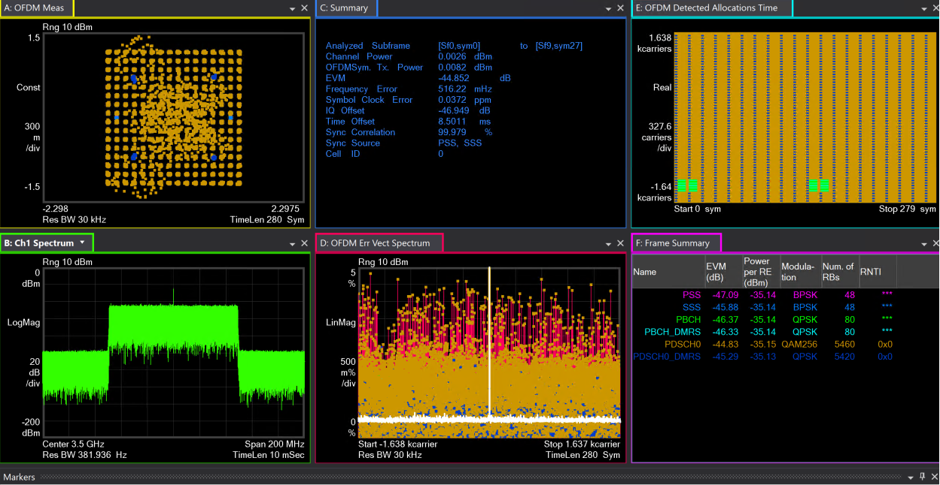
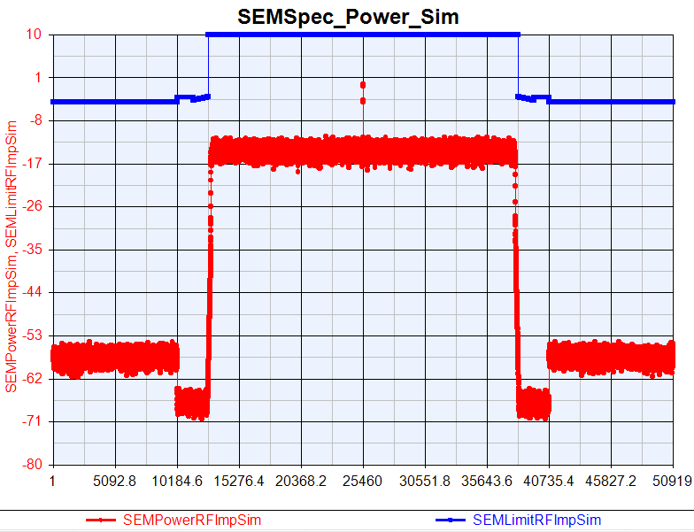
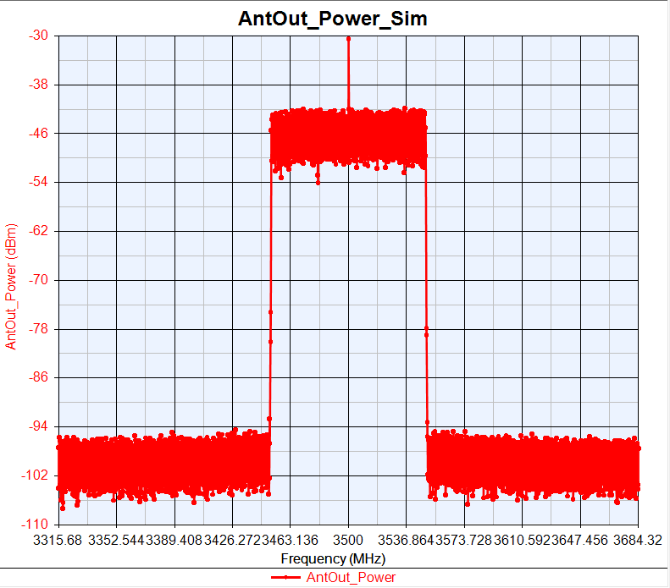
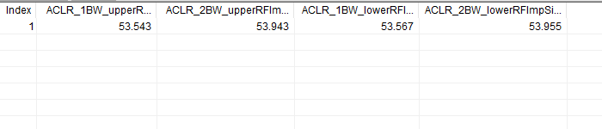
VXT-II vs SV Sim: PhaseNoise =[100, -62.133, 1000, -71.072, 1e4, -83.607]
NR DL 100MBW Tx Cable
VXT-II
EVM:-44.057dB
IQoffset:-47.194dB
EVM:-44.852dB
IQoffset:-46.949dB
Sim

Slide 20
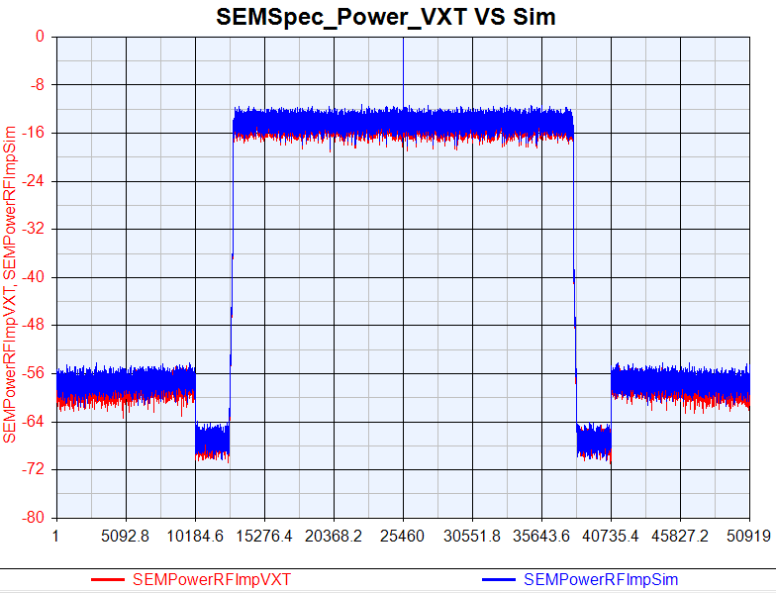
VXT SEM vs SV SEM: PhaseNoise =[100, -62.133, 1000, -71.072, 1e4, -83.607]
NR DL 100MBW Tx Cable

Slide 21
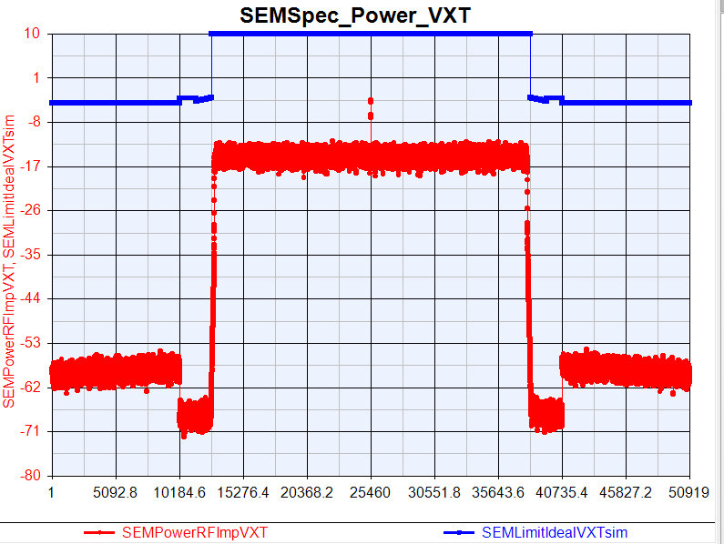
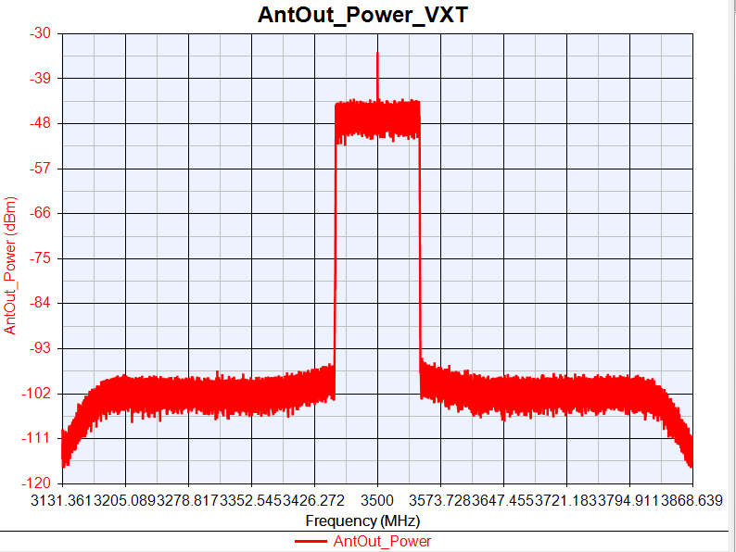
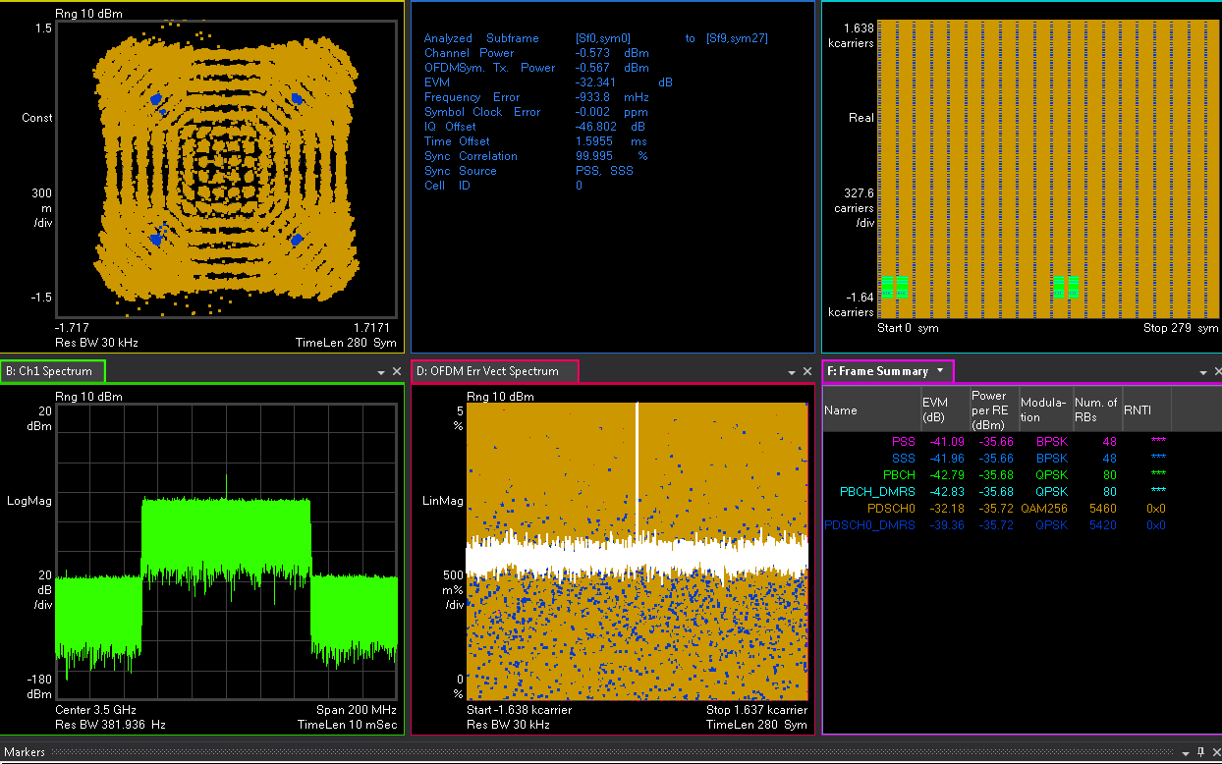
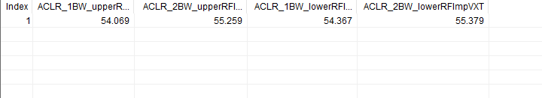
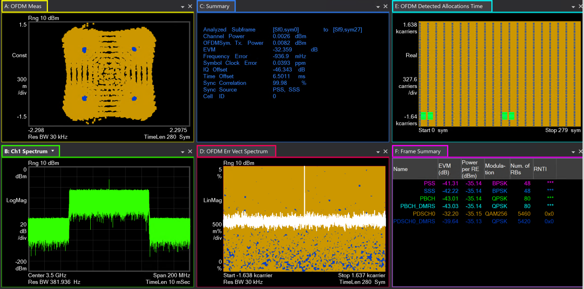



VXT-II vs SV Sim: PhaseNoise = [100, -57.133, 1000, -66.072, 1e4, -78.607]
NR DL 100MBW Tx Cable
VXT-II
EVM:-32.341dB
IQoffset:46.802dB
EVM:-32.359dB
IQoffset:-46.343dB
Sim

Slide 22

VXT SEM vs SV SEM: PhaseNoise = [100, -57.133, 1000, -66.072, 1e4, -78.607]
NR DL 100MBW Tx Cable

Slide 23
NR DL SISO Tx EVM/ACLR vs DAC_Nbits
NR DL 100MHz SV Sim vs VXT-II Test
RF Imp | EVM(dB) |  |  | 1BW_Upper_ACLR |  |  | 1BW_Lower_ACLR
DAC Nbits (Bits) | VXT | Sim | Delta | VXT | Sim | Delta | VXT | Sim | Delta
14 | -48.458 | -49.843 | 1.385 | 53.743 | 53.563 | 0.18 | 53.926 | 53.579 | 0.347
12 | -48.434 | -48.813 | 0.379 | 53.773 | 53.507 | 0.224 | 54.005 | 53.502 | 0.503
10 | -48.299 | -49.204 | 0.905 | 52.503 | 52.285 | 0.218 | 52.685 | 52.281 | 0.404
VXT-II NR Tx Cable Test Parameters
Power(dBm) | Ndensity(dBm/Hz) | PA_TOI(dBm) | Gain Imbalance(dB) | IQ Offset | Phase Noise(dBc/Hz)
0 | -133.9 | 30 | 0.002 | 0.0044 | [100, -97.133, 1000, -106.072, 1e4, -118.607]

Slide 24


VXT-II vs SV Sim: DAC_Nbits=14
NR DL 100MBW Tx Cable
VXT-II
EVM:-48.458dB
IQoffset:-47.301dB
EVM:-49.843dB
IQoffset:-47.106dB
Sim

Slide 25
VXT SEM vs SV SEM: DAC_Nbits=14
NR DL 100MBW Tx Cable

Slide 26








VXT-II vs SV Sim: DAC_Nbits=12
NR DL 100MBW Tx Cable
VXT-II
EVM:-48.434dB
IQoffset:-47.231dB
EVM:-48.813dB
IQoffset:-47.094dB
Sim

Slide 27

VXT SEM vs SV SEM: DAC_Nbits=12
NR DL 100MBW Tx Cable

Slide 28








VXT-II vs SV Sim: DAC_Nbits=10
NR DL 100MBW Tx Cable
VXT-II
EVM:-48.299dB
IQoffset:-47.494dB
EVM:-49.204dB
IQoffset:-47.121dB
Sim

Slide 29

VXT SEM vs SV SEM: DAC_Nbits=10
NR DL 100MBW Tx Cable

Slide 30
NR DL SISO Tx EVM/ACLR vs Gain Imbalance
NR DL 100MHz SV Sim vs VXT-II Test
RF Imp | EVM(dB) |  |  | 1BW_Upper_ACLR |  |  | 1BW_Lower_ACLR
Gain Imbalance (dB) | VXT | Sim | Delta | VXT | Sim | Delta | VXT | Sim | Delta
0.02 | -48.323 | -49.2 | 0.877 | 53.876 | 53.584 | 0.292 | 54.134 | 53.575 | 0.559
0.03 | -47.5 | -48.261 | 0.761 | 53.898 | 53.561 | 0.337 | 54.106 | 53.593 | 0.513
0.1 | -42.374 | -43.165 | 0.791 | 54.046 | 53.591 | 0.455 | 54.305 | 53.588 | 0.717
0.3 | -34.544 | -34.746 | 0.202 | 54.071 | 53.569 | 0.502 | 54.308 | 53.59 | 0.718
VXT-II NR Tx Cable Test Parameters
Power(dBm) | Ndensity(dBm/Hz) | PA_TOI(dBm) | DAC_Nbits(Bits) | IQ Offset | Phase Noise(dBc/Hz)
0 | -133.9 | 30 | 14 | 0.0044 | [100, -97.133, 1000, -106.072, 1e4, -118.607]

Slide 31








VXT-II vs SV Sim: Gain Imbalance=0.02
NR DL 100MBW Tx Cable
VXT-II
EVM:-48.323dB
IQoffset:-47.442dB
EVM:-49.2dB
IQoffset:-47.144dB
Sim

Slide 32

VXT SEM vs SV SEM: Gain Imbalance=0.02
NR DL 100MBW Tx Cable

Slide 33








VXT-II vs SV Sim: Gain Imbalance=0.02
NR DL 100MBW Tx Cable
VXT-II
EVM:-47.5dB
IQoffset:-47.344dB
EVM:-48.261dB
IQoffset:-47.139dB
Sim

Slide 34

VXT SEM VS Sim SEM: Gain Imbalance=0.02
NR DL 100MBW Tx Cable

Slide 35








VXT-II vs SV Sim: Gain Imbalance=0.1
NR DL 100MBW Tx Cable
VXT-II
EVM:-42.374dB
IQoffset:-47.161dB
EVM:-43.165dB
IQoffset:-47.16dB
Sim

Slide 36

VXT SEM VS Sim SEM : Gain Imbalance=0.1
NR DL 100MBW Tx Cable

Slide 37








VXT-II vs SV Sim: Gain Imbalance=0.3
NR DL 100MBW Tx Cable
VXT-II
EVM:-34.544dB
IQoffset:-47.223dB
EVM:-34.746dB
IQoffset:-47.117dB
Sim

Slide 38

VXT SEM VS Sim SEM : Gain Imbalance=0.3
NR DL 100MBW Tx Cable

Slide 39
NR DL SISO Tx EVM/ACLR vs IQ offset
NR DL 100MHz SV Sim vs VXT-II Test
RF Imp | EVM(dB) |  |  | 1BW_Upper_ACLR |  |  | 1BW_Lower_ACLR
IQ offset | VXT | Sim | Delta | VXT | Sim | Delta | VXT | Sim | Delta
0.014 | -48.308 | -49.806 | 1.498 | 53.839 | 53.603 | 0.236 | 54.134 | 53.586 | 0.548
0.025 | -48.302 | -49.553 | 1.251 | 53.852 | 53.602 | 0.25 | 54.143 | 53.607 | 0.536
0.2 | -41.065 | -42.133 | 1.068 | 54.045 | 53.421 | 0.624 | 54.269 | 53.449 | 0.82
0.4 | -32.981 | -33.456 | 0.475 | 54.07 | 53.377 | 0.693 | 54.284 | 53.388 | 0.896
VXT-II NR Tx Cable Test Parameters
Power(dBm) | Ndensity(dBm/Hz) | PA_TOI(dBm) | DAC_Nbits (Bits) | Gain Imbalance (dB) | Phase Noise(dBc/Hz)
0 | -133.9 | 30 | 14 | 0.002 | [100, -97.133, 1000, -106.072, 1e4, -118.607]

Slide 40








VXT-II vs SV Sim: IQ offset=0.014
NR DL 100MBW Tx Cable
VXT-II
EVM:-48.308dB
IQoffset:-40.798dB
EVM:-49.806dB
IQoffset:-41.287dB
Sim

Slide 41

VXT SEM VS Sim SEM : IQ offset=0.014
NR DL 100MBW Tx Cable

Slide 42








VXT-II vs SV Sim: IQ offset=0.025
NR DL 100MBW Tx Cable
VXT-II
EVM:-48.302dB
IQoffset:-36.779dB
EVM:-49.553dB
IQoffset:-36.658dB
Sim

Slide 43

VXT SEM VS Sim SEM : IQ offset=0.025
NR DL 100MBW Tx Cable

Slide 44








VXT-II vs SV Sim: IQ offset=0.2
NR DL 100MBW Tx Cable
VXT-II
EVM:-41.056dB
IQoffset:-40.803dB
EVM:-42.133dB
IQoffset:-40.764dB
Sim

Slide 45

VXT SEM VS Sim SEM : IQ offset=0.2
NR DL 100MBW Tx Cable

Slide 46








VXT-II vs SV Sim: IQ offset=0.4
NR DL 100MBW Tx Cable
VXT-II
EVM:-32.981dB
IQoffset:-42.814dB
EVM:-33.456dB
IQoffset:-42.827dB
Sim

Slide 47

VXT SEM VS Sim SEM : IQ offset=0.4
NR DL 100MBW Tx Cable

Slide 48
NR DL SISO Tx EVM/ACLR vs Combine RFImp
NR DL 100MHz SV Sim vs VXT-II Test
RF Imp | EVM(dB) |  |  | 1BW_Upper_ACLR |  |  | 1BW_Lower_ACLR
Combine Test | VXT | Sim | Delta | VXT | Sim | Delta | VXT | Sim | Delta
Origin Para | -48.256 | -49.847 | 1.591 | 53.746 | 53.591 | 0.155 | 53.966 | 53.578 | 0.388
Change 5dB | -45.294 | -46.33 | 1.036 | 50.969 | 51.347 | 0.378 | 51.21 | 51.369 | 0.159
Change 10dB | -37.388 | -37.69 | 0.302 | 43.794 | 44.096 | 0.312 | 43.969 | 44.182 | 0.213
VXT-II NR Tx Cable Test Parameters
RF Imp | PA_TOI(dBm) | Power (dBm) | Ndensity (dBm/Hz) | IQ offset | DAC_Nbits (Bits) | Gain Imbalance (dB) | Phase Noise(dBc/Hz)
Origin Para | 30 | 0 | -133.9 | 30 | 14 | 0.002 | [100, -97.133, 1000, -106.072, 1e4, -118.607]
Change 5dB | 25 | 0 | -133.9 | 0.0079 | 12 | 0.01 | 100, -92.133, 1000, -101.072, 1e4, -113.607]
Change 10dB | 20 | 0 | -133.9 | 0.014 | 10 | 0.02 | 100, -87.133, 1000, -96.072, 1e4, -108.607]

Slide 49








VXT-II vs SV Sim: Origin Para
NR DL 100MBW Tx Cable
VXT-II
EVM:-48.256dB
IQoffset:-47.392dB
EVM:-49.847dB
IQoffset:-47.147dB
Sim

Slide 50

VXT SEM VS Sim SEM : Origin Para
NR DL 100MBW Tx Cable

Slide 51








VXT-II vs SV Sim: Change 5dB
NR DL 100MBW Tx Cable
VXT-II
EVM:-45.294dB
IQoffset:-44.951dB
EVM:-46.33dB
IQoffset:-45.377dB
Sim

Slide 52

VXT SEM VS Sim SEM : Change 5dB
NR DL 100MBW Tx Cable

Slide 53








VXT-II vs SV Sim: Change 10dB
NR DL 100MBW Tx Cable
VXT-II
EVM:-37.388dB
IQoffset:-40.8dB
EVM:-37.69dB
IQoffset:-41.316dB
Sim

Slide 54

VXT SEM VS Sim SEM : Change 10dB
NR DL 100MBW Tx Cable

Slide 55
NR DL SISO Tx EVM/ACLR OTA Test
NR DL 100MHz SV Sim vs VXT-II Test
 | EVM(dB) |  |  | 1BW_Upper_ACLR |  |  | 1BW_Lower_ACLR
OTA Test | VXT | Sim | Delta | VXT | Sim | Delta | VXT | Sim | Delta
Ideal Signal | -42.26 | -42.29 | 0.03 | 44.46 | 43.096 | 1.364 | 44.84 | 43.104 | 1.736
RFImp Signal | -34.409 | -34.924 | 0.515 | 41.013 | 40.712 | 0.301 | 40.823 | 40.744 | 0.079
VXT-II NR Tx OTA Test Parameters(Length=2.5m,Pathloss=-54.7dBm)
RF Imp | PA_TOI(dBm) | Power (dBm) | Ndensity (dBm/Hz) | IQ offset | DAC_Nbits (Bits) | Gain Imbalance (dB) | Phase Noise(dBc/Hz)
Ideal RFImp (仪表参数) |  | 10 | -158.7 | 0.0045 | 14 | 0.002 | [100 -98.57 1e3 -107.56 1e4 -121.67]
Test RFImp | 20 | 10 | -158.7 | 0.045 | 12 | 0.02 | [100 -88.57 1e3 -97.56 1e4 -111.67]

Slide 56








VXT-II vs SV Sim: Ideal signal
NR DL 100MBW Tx OTA
VXT-II
EVM=-42.26
IQ offset=-46.947
EVM=-42. 29
IQ offset=-47.115
Sim

Slide 57

VXT SEM VS Sim SEM : Ideal signal
NR DL 100MBW Tx OTA

Slide 58








VXT-II vs SV Sim: RFImp signal
NR DL 100MBW Tx OTA
VXT-II
EVM=-34.409
IQ offset=-35.376
EVM=-34.924
IQ offset=-35.443
Sim

Slide 59

VXT SEM VS Sim SEM : RFImp signal
NR DL 100MBW Tx OTA

Slide 60
NR UL SISO Sensitivity EVM/Throughput vs Noise Figure
NR UL 100MHz SV Sim vs VXT-II Test
Noise Figure(dB) | VXT_EVM (%) | Sim_EVM (%) | Delta (%) | VXT_SNR (dB) | Sim_SNR (dB) | Delta (dB) | VXT_ Throughput (%) | Sim_ Throughput (%)
0 | 75.797 | 77.288 | 1.491 | 2.407 | 2.238 | 0.169 | 100 | 100
5 | 123.972 | 125.789 | 1.817 | -1.866 | -1.993 | 0.127 | 100 | 100
7 | 185.612 | 167.28 | 18.332 | -5.372 | -4.469 | 0.903 | 68 | 90
10 | 323.36 | 333.448 | 10.088 | -10.194 | -10.461 | 0.267 | 0 | 0
VXT-II NR Sensitivity Cable Test Parameters
Power(dBm) | Ndensity(dBm/Hz) | Gain Imbalance(dB) | ADC_Nbits(Bits) | IQ offset | Phase Noise(dBc/Hz)
0 | -133.9 | 0.002 | 14 | 0.0044 | [100, -97.133, 1000, -106.072, 1e4, -118.607]

Slide 61










VXT-II vs SV Sim: Noise Figure=0
NR UL 100MBW Sensitivity Cable
VXT-II
Sim

Slide 62










VXT-II vs SV Sim: Noise Figure=5
NR UL 100MBW Sensitivity Cable
VXT-II
Sim

Slide 63










VXT-II vs SV Sim: Noise Figure=7
NR UL 100MBW Sensitivity Cable
VXT-II
Sim

Slide 64










VXT-II vs SV Sim: Noise Figure=5
NR UL 100MBW Sensitivity Cable
VXT-II
Sim

Slide 65
NR DL SISO Sensitivity EVM/Throughput vs Phase Noise
NR UL 100MHz SV Sim vs VXT-II Test
Phase Noise (dBc/Hz) | VXT_EVM (%) | Sim_EVM (%) | Delta (%) | VXT_SNR (dB) | Sim_SNR (dB) | Delta (dB) | VXT_ Throughput (%) | Sim_ Throughput (%)
Change 10dB | 76.216 | 78.395 | 2.179 | 2.359 | 2.114 | 0.245 | 100 | 100
Change 15dB | 78.29 | 78.628 | 0.338 | 2.126 | 2.088 | 0.038 | 100 | 100
Change 65dB | 150.145 | 139.692 | 10.453 | -3.53 | -2.903 | 0.627 | 64 | 60
VXT-II NR Sensitivity Cable Test Parameters
Power(dBm) | Ndensity(dBm/Hz) | Gain Imbalance(dB) | ADC_Nbits(Bits) | IQ offset | Noise Figure(dB)
0 | -133.9 | 0.002 | 14 | 0.0044 | 0

Slide 66










VXT-II vs SV Sim: Phase Noise= [100, -87.133, 1000, -96.072, 1e4, -108.607]
NR UL 100MBW Sensitivity Cable
VXT-II
Sim

Slide 67










VXT-II vs SV Sim: Phase Noise= [100, -82.133, 1000, -91.072, 1e4, -103.607]
NR UL 100MBW Sensitivity Cable
VXT-II
Sim

Slide 68










VXT-II vs SV Sim: Phase Noise =[100, -32.133, 1000, -41.072, 1e4, -53.607]
NR UL 100MBW Sensitivity Cable
VXT-II
Sim

Slide 69
NR DL SISO Sensitivity EVM/Throughput vs Gain Imbalance
NR UL 100MHz SV Sim vs VXT-II Test
Gain Imbalance (dB) | VXT_EVM (%) | Sim_EVM (%) | Delta (%) | VXT_SNR (dB) | Sim_SNR (dB) | Delta (dB) | VXT_ Throughput (%) | Sim_ Throughput (%)
0.02 | 77.61 | 79.184 | 1.574 | 2.202 | 2.027 | 0.175 | 100 | 100
0.03 | 80.095 | 82.13 | 2.035 | 1.928 | 1.71 | 0.218 | 100 | 100
20 | 151.952 | 152.79 | 0.838 | -3.634 | -3.682 | 0.048 | 88 | 70
VXT-II NR Sensitivity Cable Test Parameters
Power(dBm) | Ndensity(dBm/Hz) | Noise Figure(dB) | ADC_Nbits(Bits) | IQ offset | Phase Noise(dBc/Hz)
0 | -133.9 | 0 | 14 | 0.0044 | [100, -97.133, 1000, -106.072, 1e4, -118.607]

Slide 70










VXT-II vs SV Sim : Gain Imbalance=0.02
NR UL 100MBW Sensitivity Cable
VXT-II
Sim

Slide 71










VXT-II vs SV Sim : Gain Imbalance=0.03
NR UL 100MBW Sensitivity Cable
VXT-II
Sim

Slide 72










VXT-II vs SV Sim : Gain Imbalance=20
NR UL 100MBW Sensitivity Cable
VXT-II
Sim

Slide 73
NR DL SISO Sensitivity EVM/Throughput vs IQ offset
NR UL 100MHz SV Sim vs VXT-II Test
IQ offset | VXT_EVM (%) | Sim_EVM (%) | Delta (%) | VXT_SNR (dB) | Sim_SNR (dB) | Delta (dB) | VXT_ Throughput (%) | Sim_ Throughput (%)
0.014 | 78.095 | 78.846 | 0.751 | 2.148 | 2.064 | 0.084 | 100 | 100
0.025 | 84.547 | 84.778 | 0.231 | 1.458 | 1.434 | 0.024 | 100 | 100
1.2 | 624.005 | 655.333 | 31.328 | -15.904 | -16.328 | 0.424 | 58 | 50
VXT-II NR Sensitivity Cable Test Parameters
Power(dBm) | Ndensity(dBm/Hz) | Noise Figure (dB) | ADC_Nbits (Bits) | Gain Imbalance (dB) | Phase Noise(dBc/Hz)
0 | -133.9 | 0 | 14 | 0.002 | [100, -97.133, 1000, -106.072, 1e4, -118.607]

Slide 74










VXT-II vs SV Sim : IQ offset=0.014
NR UL 100MBW Sensitivity Cable
VXT-II
Sim

Slide 75










VXT-II vs SV Sim : IQ offset=0.025
NR UL 100MBW Sensitivity Cable
VXT-II
Sim

Slide 76










VXT-II vs SV Sim : IQ offset=1.2
NR UL 100MBW Sensitivity Cable
VXT-II
Sim

Slide 77
NR DL SISO Sensitivity EVM/Throughput vs ADC_Nbits
NR UL 100MHz SV Sim vs VXT-II Test
ADC_ Nbits (Bits) | VXT_EVM (%) | Sim_EVM (%) | Delta (%) | VXT_SNR (dB) | Sim_SNR (dB) | Delta (dB) | VXT_ Throughput (%) | Sim_ Throughput (%)
14 | 75.797 | 77.288 | 1.491 | 2.407 | 2.238 | 0.169 | 100 | 100
12 | 78.357 | 80.035 | 1.678 | 2.118 | 1.934 | 0.184 | 100 | 100
10 | 79.693 | 81.703 | 2.01 | 1.972 | 1.755 | 0.217 | 100 | 100
VXT-II NR Sensitivity Cable Test Parameters
Power(dBm) | Ndensity(dBm/Hz) | Noise Figure (dB) | IQ offset(dB) | Gain Imbalance (dB) | Phase Noise(dBc/Hz)
0 | -133.9 | 0 | 0.0044 | 0.002 | [100, -97.133, 1000, -106.072, 1e4, -118.607]

Slide 78
VXT-II vs SV Sim : ADC_Nbits=14
NR UL 100MBW Sensitivity Cable
VXT-II
Sim

Slide 79










VXT-II vs SV Sim : ADC_Nbits=12
NR UL 100MBW Sensitivity Cable
VXT-II
Sim

Slide 80










VXT-II vs SV Sim: ADC_Nbits=10
NR UL 100MBW Sensitivity Cable
VXT-II
Sim

Slide 81
NR UL SISO Sensitivity EVM/Throughput vs Combine RFImp
NR UL 100MHz SV Sim vs VXT-II Test
Combine Test | VXT_EVM (%) | Sim_EVM (%) | Delta (%) | VXT_SNR (dB) | Sim_SNR (dB) | Delta (dB) | VXT_ Throughput (%) | Sim_ Throughput (%)
Origin | 75.797 | 77.288 | 1.491 | 2.407 | 2.238 | 0.169 | 100 | 100
Change 5dB | 134.103 | 135.736 | 1.633 | -2.549 | -2.654 | 0.105 | 100 | 100
Change 10dB | 186.985 | 209.631 | 22.646 | -5.436 | -6.429 | 0.993 | 74 | 50
VXT-II NR Sensitivity Cable Test Parameters
RF Imp | Noise Figure(dB) | Power (dBm) | Ndensity (dBm/Hz) | IQ offset | ADC_Nbits (Bits) | Gain Imbalance (dB) | Phase Noise(dBc/Hz)
Origin Para | 0 | 0 | -133.9 | 0.0044 | 14 | 0.002 | [100, -97.133, 1000, -106.072, 1e4, -118.607]
Change 5dB | 5 | 0 | -133.9 | 0.0079 | 12 | 0.01 | 100, -92.133, 1000, -101.072, 1e4, -113.607]
Change 10dB | 7 | 0 | -133.9 | 0.014 | 10 | 0.02 | 100, -87.133, 1000, -96.072, 1e4, -108.607]

Slide 82
VXT-II vs SV Sim: Origin Para
NR UL 100MBW Sensitivity Cable
VXT-II
Sim

Slide 83










VXT-II vs SV Sim : Change 5dB
NR UL 100MBW Sensitivity Cable
VXT-II
Sim

Slide 84










VXT-II vs SV Sim: Change 10dB
NR UL 100MBW Sensitivity Cable
VXT-II
Sim

Slide 85
NR UL SISO Sensitivity EVM/Throughput OTA Test
NR UL 100MHz SV Sim vs VXT-II Test
OTA Test | VXT_EVM (%) | Sim_EVM (%) | Delta (%) | VXT_SNR (dB) | Sim_SNR (dB) | Delta (dB) | VXT_ Throughput (%) | Sim_ Throughput (%)
Ideal | 78.97 | 78.121 | 0.849 | 2.051 | 2.145 | 0.094 | 100 | 100
RFImp | 142.852 | 141.416 | 1.436 | -3.098 | -3.01 | 0.088 | 100 | 100
VXT-II NR Sensitivity OTA Test Parameters(Length=2.5m,Pathloss=-54.7dBm)
RF Imp | Noise Figure(dB) | Power (dBm) | Ndensity (dBm/Hz) | IQ offset | DAC_Nbits (Bits) | Gain Imbalance (dB) | Phase Noise(dBc/Hz)
Ideal RFImp (仪表参数) |  | 10 | -158.7 | 0.0045 | 14 | 0.002 | [100 -98.57 1e3 -107.56 1e4 -121.67]
Test RFImp | 5 | 10 | -158.7 | 0.045 | 12 | 0.02 | [100 -88.57 1e3 -97.56 1e4 -111.67]

Slide 86










VXT-II vs SV Sim: Ideal Signal
NR UL 100MBW Sensitivity OTA
VXT-II
Sim

Slide 87










VXT-II vs SV Sim: RFImp Signal
NR UL 100MBW Sensitivity ota
VXT-II
Sim

Slide 88
NR UL SISO Narrow Blocking EVM/Throughput vs Noise Figure
NR UL 100MHz SV Sim vs VXT-II Test
Noise Figure (dB) | VXT_EVM(dB) | Sim_EVM(dB) | Delta(dB) | VXT_Throughput(%) | Sim_Throghput(%)
0 | -8.099 | -7.971 | 0.128 | 100 | 100
5 | -3.329 | -3.236 | 0.093 | 100 | 100
10 | 1.909 | 1.962 | 0.053 | 100 | 100
13 | 5.688 | 5.753 | 0.065 | 60 | 15
VXT-II NR Narrow Blocking Cable Test Parameters
Power(dBm) | Ndensity(dBm/Hz) | Gain Imbalance(dB) | ADC_Nbits(Bits) | IQ offset | Phase Noise(dBc/Hz)
0 | -133.9 | 0.002 | 14 | 0.00045 | [100, -97.133, 1000, -106.072, 1e4, -118.607]

Slide 89









VXT-II vs SV Sim: Noise Figure=0
NR UL 100MBW Narrow Blocking Cable
VXT-II
Sim

Slide 90










VXT-II vs SV Sim: Noise Figure=5
NR UL 100MBW Narrow Blocking Cable
VXT-II
Sim

Slide 91










VXT-II vs SV Sim: Noise Figure=10
NR UL 100MBW Narrow Blocking Cable
VXT-II
Sim

Slide 92










VXT-II vs SV Sim: Noise Figure=13
NR UL 100MBW Narrow Blocking Cable
VXT-II
Sim

Slide 93
NR UL SISO Narrow Blocking EVM/Throughput vs Phase Noise
NR UL 100MHz SV Sim vs VXT-II Test
Phase Noise (dBc/Hz) | VXT_EVM(dB) | Sim_EVM(dB) | Delta(dB) | VXT_Throughput(%) | Sim_Throghput(%)
-10dB | -7.385 | -7.449 | 0.064 | 100 | 100
-15dB | -7.191 | -7.17 | 0.021 | 100 | 100
-70dB | 3.916 | 4.182 | 0.266 | 30 | 25
VXT-II NR Narrow Blocking Cable Test Parameters
Power(dBm) | Ndensity(dBm/Hz) | Gain Imbalance(dB) | ADC_Nbits(Bits) | IQ offset | Noise Figure(dB)
0 | -133.9 | 0.002 | 14 | 0.00045 | 0

Slide 94










VXT-II vs SV Sim: Phase Noise =[100, -87.133, 1000, -96.072, 1e4, -108.607]
NR UL 100MBW Narrow Blocking Cable
VXT-II
Sim

Slide 95










VXT-II vs SV Sim: Phase Noise =[100, -82.133, 1000, -91.072, 1e4, -103.607]
NR UL 100MBW Narrow Blocking Cable
VXT-II
Sim

Slide 96










VXT-II vs SV Sim: Phase Noise =[100, -27.133, 1000, -36.072, 1e4, -48.607]
NR UL 100MBW Narrow Blocking Cable
VXT-II
Sim

Slide 97
NR UL SISO Narrow Blocking EVM/Throughput vs Gain Imbalance
NR UL 100MHz SV Sim vs VXT-II Test
Gain Imbalance (dB) | VXT_EVM(dB) | Sim_EVM(dB) | Delta(dB) | VXT_Throughput(%) | Sim_Throghput(%)
0.02 | -7.81 | -7.802 | 0.008 | 100 | 100
0.03 | -7.637 | -7.545 | 0.092 | 100 | 100
16 | -0.576 | -0.65 | 0.074 | 55 | 65
VXT-II NR Narrow Blocking Cable Test Parameters
Power(dBm) | Noise Figure(dB) | Ndensity(dBm/Hz) | ADC_Nbits(Bits) | IQ offset | Phase Noise(dBc/Hz)
0 | 0 | -133.9 | 14 | 0.00045 | [100, -97.133, 1000, -106.072, 1e4, -118.607]

Slide 98










VXT-II vs SV Sim : Gain Imbalance =0.02
NR UL 100MBW Narrow Blocking Cable
VXT-II
Sim

Slide 99










VXT-II vs SV Sim : Gain Imbalance =0.03
NR UL 100MBW Narrow Blocking Cable
VXT-II
Sim

Slide 100










VXT-II vs SV Sim : Gain Imbalance =16
NR UL 100MBW Narrow Blocking Cable
VXT-II
Sim

Slide 101
NR UL SISO Narrow Blocking EVM/Throughput vs IQ offset
NR UL 100MHz SV Sim vs VXT-II Test
IQ offset | VXT_EVM(dB) | Sim_EVM(dB) | Delta(dB) | VXT_Throughput(dB) | Sim_Throghput(dB)
0.0014 | -6.817 | -6.222 | 0.595 | 100 | 100
0.0045 | -3.336 | -3.321 | 0.015 | 100 | 100
0.05 | 24.488 | 24.066 | 0.422 | 5 | 5
VXT-II NR Narrow Blocking Cable Test Parameters
Power(dBm) | Noise Figure(dB) | Ndensity(dBm/Hz) | ADC_Nbits (Bits) | Gain Imbalance(dB) | Phase Noise(dBc/Hz)
0 | 0 | -133.9 | 14 | 0.002 | [100, -97.133, 1000, -106.072, 1e4, -118.607]

Slide 102










VXT-II vs SV Sim : IQ offset=0.0014
NR UL 100MBW Narrow Blocking Cable
VXT-II
Sim

Slide 103










VXT-II vs SV Sim : IQ offset=0.0025
NR UL 100MBW Narrow Blocking Cable
VXT-II
Sim

Slide 104










VXT-II vs SV Sim : IQ offset=0.05
NR UL 100MBW Narrow Blocking Cable
VXT-II
Sim

Slide 105
NR UL SISO Narrow Blocking EVM/Throughput vs ADC_Nbits
NR UL 100MHz SV Sim vs VXT-II Test
ADC_Nbits (Bits) | VXT_EVM(dB) | Sim_EVM(dB) | Delta(dB) | VXT_Throughput(%) | Sim_Throghput(%)
14 | -8.099 | -7.971 | 0.128 | 100 | 100
12 | -7.891 | -7.912 | 0.021 | 100 | 100
10 | -7.652 | -7.698 | 0.046 | 100 | 100
VXT-II NR Narrow Blocking Cable Test Parameters
Power(dBm) | Noise Figure(dB) | Ndensity(dBm/Hz) | IQ offset | Gain Imbalance(dB) | Phase Noise(dBc/Hz)
0 | 0 | -133.9 | 0.00045 | 0.002 | [100, -97.133, 1000, -106.072, 1e4, -118.607]

Slide 106

VXT-II vs SV Sim : ADC_Nbits=14
NR UL 100MBW Narrow Blocking Cable
VXT-II
Sim

Slide 107










VXT-II vs SV Sim : ADC_Nbits=12
NR UL 100MBW Narrow Blocking Cable
VXT-II
Sim

Slide 108










VXT-II vs SV Sim : ADC_Nbits=10
NR UL 100MBW Narrow Blocking Cable
VXT-II
Sim

Slide 109
NR UL SISO Narrow Blocking EVM/Throughput vs Combine RFImp
NR UL 100MHz SV Sim vs VXT-II Test
Combine Test | VXT_EVM(dB) | Sim_EVM(dB) | Delta(dB) | VXT_Throughput(dB) | Sim_Throghput(dB)
Origin Para | -8.099 | -7.971 | 0.128 | 100 | 100
Change 5dB | -3.001 | -2.986 | 0.015 | 100 | 100
Change 10dB | 2.924 | 3.073 | 0.149 | 100 | 100
VXT-II NR Narrow Blocking Cable Test Parameters
RF Imp | Noise Figure(dB) | Power (dBm) | Ndensity (dBm/Hz) | IQ offset | ADC_Nbits (Bits) | Gain Imbalance (dB) | Phase Noise(dBc/Hz)
Origin Para | 0 | 0 | -133.9 | 0.00045 | 14 | 0.002 | [100, -97.133, 1000, -106.072, 1e4, -118.607]
Change 5dB | 5 | 0 | -133.9 | 0.00079 | 12 | 0.01 | 100, -92.133, 1000, -101.072, 1e4, -113.607]
Change 10dB | 10 | 0 | -133.9 | 0.0014 | 10 | 0.02 | 100, -87.133, 1000, -96.072, 1e4, -108.607]

Slide 110
VXT-II vs SV Sim : Origin Para
NR UL 100MBW Narrow Blocking Cable
VXT-II
Sim

Slide 111










VXT-II vs SV Sim : Change 5dB
NR UL 100MBW Narrow Blocking Cable
VXT-II
Sim

Slide 112










VXT-II vs SV Sim : Change 10dB
NR UL 100MBW Narrow Blocking Cable
VXT-II
Sim

Slide 113
NR UL SISO Narrow Blocking EVM/Throughput OTA Test
NR UL 100MHz SV Sim vs VXT-II Test
Narrow Blocking | Test_EVM(dB) | Sim_EVM(dB) | Delta(dB) | Test_Throughput(%) | Sim_Throughput(%)
Ideal | -7.658 | -7.773 | 0.115 | 100 | 100
RFImp | -2.874 | -2.685 | 0.189 | 100 | 100
VXT-II NR Narrow Blocking OTA Test Parameters(Length=1.1m,Pathloss=-46dBm)
RF Imp | Noise Figure(dB) | Power (dBm) | Ndensity (dBm/Hz) | IQ offset | ADC_Nbits (Bits) | Gain Imbalance (dB) | Phase Noise(dBc/Hz)
Ideal RFImp (仪表参数) |  | 15 | -156.3 | 0.00002 | 14 | 0.002 | [100 -98.57 1e3 -107.56 1e4 -121.67]
Test RFImp | 5 | 15 | -156.3 | 0.002 | 12 | 0.02 | [100 -88.57 1e3 -97.56 1e4 -111.67]

Slide 114










VXT-II vs SV Sim : Ideal Signal
NR UL 100MBW Narrow Blocking OTA
VXT-II
Sim

Slide 115










VXT-II vs SV Sim : RFImp Signal
NR UL 100MBW Narrow Blocking OTA
VXT-II
Sim

Slide 116
NR UL SISO General Blocking EVM/Throughput vs Noise Figure
NR UL 100MHz SV Sim vs VXT-II Test
Noise Figure (dB) | VXT_EVM(dB) | Sim_EVM(dB) | Delta(dB) | VXT_Throughput(%) | Sim_Throghput(%)
0 | -8.05 | -7.878 | 0.172 | 100 | 100
5 | -2.865 | -2.712 | 0.153 | 100 | 100
10 | 2.366 | 2.19 | 0.176 | 100 | 100
13 | 6.304 | 6.249 | 0.055 | 90 | 35
VXT-II NR General Blocking Cable Test Parameters
Power(dBm) | IQ offset | Ndensity(dBm/Hz) | ADC_Nbits (Bits) | Gain Imbalance(dB) | Phase Noise(dBc/Hz)
0 | 0.00045 | -133.9 | 14 | 0.002 | [100, -97.133, 1000, -106.072, 1e4, -118.607]

Slide 117










VXT-II vs SV Sim : Noise Figure=0
NR UL 100MBW General Blocking Cable
VXT-II
Sim

Slide 118










VXT-II vs SV Sim : Noise Figure=5
NR UL 100MBW General Blocking Cable
VXT-II
Sim

Slide 119










VXT-II vs SV Sim : Noise Figure=10
NR UL 100MBW General Blocking Cable
VXT-II
Sim

Slide 120








VXT-II vs SV Sim : Noise Figure=13
NR UL 100MBW General Blocking Cable
VXT-II
Sim

Slide 121
NR UL SISO General Blocking EVM/Throughput vs Phase Noise
NR UL 100MHz SV Sim vs VXT-II Test
Phase Noise (dBc/Hz) | VXT_EVM(dB) | Sim_EVM(dB) | Delta(dB) | VXT_Throughput(dB) | Sim_Throghput(dB)
-10dB | -7.748 | -7.723 | 0.025 | 100 | 100
-15dB | -7.605 | -7.532 | 0.073 | 100 | 100
-65dB | -3.846 | -4.051 | 0.205 | 75 | 70
VXT-II NR General Blocking Cable Test Parameters
Power(dBm) | Noise Figure(dB) | Ndensity(dBm/Hz) | ADC_Nbits (Bits) | Gain Imbalance(dB) | IQ offset
0 | 0 | -133.9 | 14 | 0.002 | 0.00045

Slide 122










VXT-II vs SV Sim : Phase Noise =[100, -87.133, 1000, -96.072, 1e4, -108.607]
NR UL 100MBW General Blocking Cable
VXT-II
Sim

Slide 123










VXT-II vs SV Sim : Phase Noise =[100, -82.133, 1000, -91.072, 1e4, -103.607]
NR UL 100MBW General Blocking Cable
VXT-II
Sim

Slide 124










VXT-II vs SV Sim : Phase Noise =[100, -32.133, 1000, -41.072, 1e4, -53.607]
NR UL 100MBW General Blocking Cable
VXT-II
Sim

Slide 125
NR UL SISO General Blocking EVM/Throughput vs Gain Imbalance
NR UL 100MHz SV Sim vs VXT-II Test
Gain Imbalance (dB) | VXT_EVM(dB) | Sim_EVM(dB) | Delta(dB) | VXT_Throughput(%) | Sim_Throghput(%)
0.02 | -7.822 | -7.588 | 0.234 | 100 | 100
0.03 | -7.785 | -7.573 | 0.212 | 100 | 100
8 | 11.205 | 11.675 | 0.47 | 95 | 75
VXT-II NR General Blocking Cable Test Parameters
Power(dBm) | Noise Figure(dB) | Ndensity(dBm/Hz) | ADC_Nbits (Bits) | IQ offset | Phase Noise(dBc/Hz)
0 | 0 | -133.9 | 14 | 0.00045 | [100, -97.133, 1000, -106.072, 1e4, 118.607]

Slide 126









VXT-II vs SV Sim : Gain Imbalance=0.02
NR UL 100MBW General Blocking Cable
VXT-II
Sim

Slide 127










VXT-II vs SV Sim : Gain Imbalance=0.03
NR UL 100MBW General Blocking Cable
VXT-II
Sim

Slide 128










VXT-II vs SV Sim : Gain Imbalance=8
NR UL 100MBW General Blocking Cable
VXT-II
Sim

Slide 129
NR UL SISO General Blocking EVM/Throughput vs IQ offset
NR UL 100MHz SV Sim vs VXT-II Test
IQ offset | VXT_EVM(dB) | Sim_EVM(dB) | Delta(dB) | VXT_Throughput | Sim_Throghput
0.0014 | -6.819 | -6.32 | 0.499 | 100 | 100
0.0045 | -3.602 | -3.485 | 0.117 | 100 | 100
0.04 | 1.762 | 1.721 | 0.041 | 25 | 25
VXT-II NR General Blocking Cable Test Parameters
Power(dBm) | Noise Figure(dB) | Ndensity(dBm/Hz) | ADC_Nbits (Bits) | Gain Imbalance(dB) | Phase Noise(dBc/Hz)
0 | 0 | -133.9 | 14 | 0.002 | [100, -97.133, 1000, -106.072, 1e4, 118.607]

Slide 130










VXT-II vs SV Sim : IQ offset=0.0014
NR UL 100MBW General Blocking Cable
VXT-II
Sim

Slide 131










VXT-II vs SV Sim : IQ offset=0.0045
NR UL 100MBW General Blocking Cable
VXT-II
Sim

Slide 132










VXT-II vs SV Sim : IQ offset=0.04
NR UL 100MBW General Blocking Cable
VXT-II
Sim

Slide 133
NR UL SISO General Blocking EVM/Throughput vs ADC_Nbits
NR UL 100MHz SV Sim vs VXT-II Test
ADC_Nbits (Bits) | VXT_EVM(dB) | Sim_EVM(dB) | Delta(dB) | VXT_Throughput(%) | Sim_Throghput(%)
14 | -8.05 | -7.878 | 0.172 | 100 | 100
12 | -7.91 | -7.886 | 0.024 | 100 | 100
10 | -7.729 | -7.621 | 0.108 | 100 | 100
VXT-II NR General Blocking Cable Test Parameters
Power(dBm) | Noise Figure(dB) | Ndensity(dBm/Hz) | IQ offset | Gain Imbalance(dB) | Phase Noise(dBc/Hz)
0 | 0 | -133.9 | 0.00045 | 0.002 | [100, -97.133, 1000, -106.072, 1e4, 118.607]

Slide 134
VXT-II vs SV Sim : ADC_Nbits=14
NR UL 100MBW General Blocking Cable
VXT-II
Sim

Slide 135










VXT-II vs SV Sim : ADC_Nbits=12
NR UL 100MBW General Blocking Cable
VXT-II
Sim

Slide 136










VXT-II vs SV Sim : ADC_Nbits=10
NR UL 100MBW General Blocking Cable
VXT-II
Sim

Slide 137
NR UL SISO General Blocking EVM/Throughput vs Combine RFImp
NR UL 100MHz SV Sim vs VXT-II Test
Combine Test | VXT_EVM(dB) | Sim_EVM(dB) | Delta(dB) | VXT_Throughput(%) | Sim_Throghput(%)
Origin Para | -8.05 | -7.878 | 0.172 | 100 | 100
Change 5dB | -3.022 | -2.841 | 0.181 | 100 | 100
Change 10dB | 2.433 | 2.327 | 0.106 | 100 | 100
VXT-II NR General Blocking Cable Test Parameters
RF Imp | Noise Figure(dB) | Power (dBm) | Ndensity (dBm/Hz) | IQ offset | ADC_Nbits (Bits) | Gain Imbalance (dB) | Phase Noise(dBc/Hz)
Origin Para | 0 | 0 | -133.9 | 0.00045 | 14 | 0.002 | [100, -97.133, 1000, -106.072, 1e4, -118.607]
Change 5dB | 5 | 0 | -133.9 | 0.00079 | 12 | 0.01 | 100, -92.133, 1000, -101.072, 1e4, -113.607]
Change 10dB | 10 | 0 | -133.9 | 0.0014 | 10 | 0.02 | 100, -87.133, 1000, -96.072, 1e4, -108.607]

Slide 138
VXT-II vs SV Sim : Origin Para
NR UL 100MBW General Blocking Cable
VXT-II
Sim

Slide 139










VXT-II vs SV Sim : Change 5dB
NR UL 100MBW General Blocking Cable
VXT-II
Sim

Slide 140










VXT-II vs SV Sim : Change 10dB
NR UL 100MBW General Blocking Cable
VXT-II
Sim

Slide 141
NR UL SISO General Blocking EVM/Throughput OTA Test
NR UL 100MHz SV Sim vs VXT-II Test
General Blocking | Test_EVM(dB) | Sim_EVM(dB) | Delta(dB) | Test_Throughput(%) | Sim_Throughput(%)
Ideal | -8.105 | -8.13 | 0.008 | 100 | 100
RFImp | -2.195 | -2.541 | 0.346 | 100 | 100
VXT-II NR General Blocking OTA Test Parameters(Length=1.1m,Pathloss=-46dBm)
RF Imp | Noise Figure(dB) | Power (dBm) | Ndensity (dBm/Hz) | IQ offset | DAC_Nbits (Bits) | Gain Imbalance (dB) | Phase Noise(dBc/Hz)
Ideal RFImp (仪表参数) |  | 15 | -156.3 | 0.00002 | 14 | 0.002 | [100 -98.57 1e3 -107.56 1e4 -121.67]
Test RFImp | 5 | 15 | -156.3 | 0.002 | 12 | 0.02 | [100 -88.57 1e3 -97.56 1e4 -111.67]

Slide 142










VXT-II vs SV Sim : Ideal Signal
NR UL 100MBW General Blocking ota
VXT-II
Sim

Slide 143










VXT-II vs SV Sim : RFImp Signal
NR UL 100MBW General Blocking ota
VXT-II
Sim

Slide 144
NR UL SISO Intermodulation EVM/Throughput vs Noise Figure
NR UL 100MHz SV Sim vs VXT-II Test
Noise Figure (dB) | VXT_EVM(dB) | Sim_EVM(dB) | Delta(dB) | VXT_Throughput(dB) | Sim_Throghput(dB)
0 | -8.379 | -8.383 | 0.004 | 100 | 100
5 | -3.32 | -3.551 | 0.231 | 100 | 100
10 | 1.853 | 1.816 | 0.037 | 100 | 100
13 | 6.401 | 6.254 | 0.147 | 15 | 30
VXT-II NR Intermodulation Cable Test Parameters
Power(dBm) | Gain Imbalance(dB) | Ndensity(dBm/Hz) | ADC_Nbits (Bits) | IQ offset | Phase Noise(dBc/Hz)
0 | 0.002 | -133.9 | 14 | 0.0006 | [100, -97.133, 1000, -106.072, 1e4, 118.607]

Slide 145










VXT-II vs SV Sim : Noise Figure=0
NR uL 100MBW Intermodulation Cable
VXT-II
Sim

Slide 146










VXT-II vs SV Sim : Noise Figure=5
NR uL 100MBW Intermodulation Cable
VXT-II
Sim

Slide 147










VXT-II vs SV Sim : Noise Figure=10
NR uL 100MBW Intermodulation Cable
VXT-II
Sim

Slide 148








VXT-II vs SV Sim : Noise Figure=13
NR uL 100MBW Intermodulation Cable
VXT-II
Sim

Slide 149
NR UL SISO Intermodulation EVM/Throughput vs Phase Noise
NR UL 100MHz SV Sim vs VXT-II Test
Phase Noise (dBc/Hz) | VXT_EVM(dB) | Sim_EVM(dB) | Delta(dB) | VXT_Throughput(%) | Sim_Throghput(%)
-10dB | -8.293 | -8.288 | 0.005 | 100 | 100
-15dB | -8.195 | -8.189 | 0.006 | 100 | 100
-65dB | -0.533 | -0.541 | 0.008 | 65 | 65
VXT-II NR Intermodulation Cable Test Parameters
Power(dBm) | Noise Figure(dB) | Ndensity(dBm/Hz) | ADC_Nbits (Bits) | IQ offset | Gain Imbalance(dB)
0 | 0 | -133.9 | 14 | 0.0006 | 0.002

Slide 150









VXT-II vs SV Sim : Phase Noise =[100, -87.133, 1000, -96.072, 1e4, -108.607]
NR uL 100MBW Intermodulation Cable
VXT-II
Sim

Slide 151










VXT-II vs SV Sim : Phase Noise =[100, -82.133, 1000, -91.072, 1e4, -103.607]
NR uL 100MBW Intermodulation Cable
VXT-II
Sim

Slide 152










VXT-II vs SV Sim : Phase Noise =[100, -32.133, 1000, -41.072, 1e4, -53.607]
NR uL 100MBW Intermodulation Cable
VXT-II
Sim

Slide 153
NR UL SISO Intermodulation EVM/Throughput vs Gain Imbalance
NR UL 100MHz SV Sim vs VXT-II Test
Gain Imbalance (dB) | VXT_EVM(dB) | Sim_EVM(dB) | Delta(dB) | VXT_Throughput(%) | Sim_Throghput(%)
0.02 | -8.061 | -8.103 | 0.042 | 100 | 100
0.03 | -7.992 | -8.032 | 0.04 | 100 | 100
16 | -1.885 | -1.758 | 0.127 | 60 | 65
VXT-II NR Intermodulation Cable Test Parameters
Power(dBm) | Noise Figure(dB) | Ndensity(dBm/Hz) | ADC_Nbits (Bits) | IQ offset | Phase Noise(dBc/Hz)
0 | 0 | -133.9 | 14 | 0.0006 | [100, -97.133, 1000, -106.072, 1e4, 118.607]

Slide 154










VXT-II vs SV Sim : Gain Imbalance=0.02
NR uL 100MBW Intermodulation Cable
VXT-II
Sim

Slide 155










VXT-II vs SV Sim : Gain Imbalance=0.03
NR uL 100MBW Intermodulation Cable
VXT-II
Sim

Slide 156










VXT-II vs SV Sim : Gain Imbalance=16
NR uL 100MBW Intermodulation Cable
VXT-II
Sim

Slide 157
NR UL SISO Intermodulation EVM/Throughput vs Phase Noise
NR UL 100MHz SV Sim vs VXT-II Test
IQ offset | VXT_EVM(dB) | Sim_EVM(dB) | Delta(dB) | VXT_Throughput(%) | Sim_Throghput(%)
0.002 | -5.935 | -5.342 | 0.593 | 100 | 100
0.0035 | -4.496 | -3.73 | 0.766 | 100 | 100
0.03 | 25.316 | 25.341 | 0.025 | 60 | 60
VXT-II NR Intermodulation Cable Test Parameters
Power(dBm) | Noise Figure(dB) | Ndensity(dBm/Hz) | ADC_Nbits (Bits) | Gain Imbalance (dB) | Phase Noise(dBc/Hz)
0 | 0 | -133.9 | 14 | 0.002 | [100, -97.133, 1000, -106.072, 1e4, 118.607]

Slide 158










VXT-II vs SV Sim : IQ offset=0.002
NR uL 100MBW Intermodulation Cable
VXT-II
Sim

Slide 159










VXT-II vs SV Sim : IQ offset=0.0035
NR uL 100MBW Intermodulation Cable
VXT-II
Sim

Slide 160








VXT-II vs SV Sim : IQ offset =0.03
NR uL 100MBW Intermodulation Cable
VXT-II
Sim

Slide 161
NR UL SISO Intermodulation EVM/Throughput vs ADC_Nbits
NR UL 100MHz SV Sim vs VXT-II Test
ADC_Nbits (Bits) | VXT_EVM | Sim_EVM | Delta | VXT_Throughput | Sim_Throghput
14 | -8.379 | -8.383 | 0.004 | 100 | 100
12 | -8.084 | -8.046 | 0.038 | 100 | 100
10 | -7.555 | -7.757 | 0.202 | 100 | 100
VXT-II NR Intermodulation Cable Test Parameters
Power(dBm) | Noise Figure(dB) | Ndensity(dBm/Hz) | IQ offset | Gain Imbalance (dB) | Phase Noise(dBc/Hz)
0 | 0 | -133.9 | 0.0006 | 0.002 | [100, -97.133, 1000, -106.072, 1e4, 118.607]

Slide 162
VXT-II vs SV Sim : ADC_Nbits=14
NR uL 100MBW Intermodulation Cable
VXT-II
Sim

Slide 163










VXT-II vs SV Sim :ADC_Nbits=12
NR uL 100MBW Intermodulation Cable
VXT-II
Sim

Slide 164










VXT-II vs SV Sim : ADC_Nbits=10
NR uL 100MBW Intermodulation Cable
VXT-II
Sim

Slide 165
NR UL SISO Intermodulation EVM/Throughput vs Combine RFImp
NR UL 100MHz SV Sim vs VXT-II Test
Combine Test | VXT_EVM | Sim_EVM | Delta | VXT_Throughput | Sim_Throghput
Origin Para | -8.379 | -8.383 | 0.004 | 100 | 100
Change 5dB | -3.104 | -2.9 | 0.204 | 100 | 100
Change 10dB | 1.972 | 2.402 | 0.43 | 100 | 100
VXT-II NR Intermodulation Cable Test Parameters
RF Imp | Noise Figure(dB) | Power (dBm) | Ndensity (dBm/Hz) | IQ offset | ADC_Nbits (Bits) | Gain Imbalance (dB) | Phase Noise(dBc/Hz)
Origin Para | 0 | 0 | -133.9 | 0.0006 | 14 | 0.002 | [100, -97.133, 1000, -106.072, 1e4, -118.607]
Change 5dB | 5 | 0 | -133.9 | 0.0011 | 12 | 0.01 | 100, -92.133, 1000, -101.072, 1e4, -113.607]
Change 10dB | 10 | 0 | -133.9 | 0.002 | 10 | 0.02 | 100, -87.133, 1000, -96.072, 1e4, -108.607]

Slide 166
VXT-II vs SV Sim : Origin Para
NR uL 100MBW Intermodulation Cable
VXT-II
Sim

Slide 167










VXT-II vs SV Sim : Change 5dB
NR uL 100MBW Intermodulation Cable
VXT-II
Sim

Slide 168










VXT-II vs SV Sim : Change 10dB
NR uL 100MBW Intermodulation Cable
VXT-II
Sim

Slide 169
NR UL SISO Intermodulation EVM/Throughput OTA Test
NR UL 100MHz SV Sim vs VXT-II Test
Intermodulation | Test_EVM(dB) | Sim_EVM(dB) | Delta(dB) | Test_Throughput(%) | Sim_Throughput(%)
Ideal | -7.911 | -7.961 | 0.05 | 100 | 100
RFImp | -2.264 | -2.133 | 0.131 | 100 | 100
VXT-II NR Intermodulation OTA Test Parameters(Length=1.1m,Pathloss=-46dBm)
RF Imp | Noise Figure(dB) | Power (dBm) | Ndensity (dBm/Hz) | IQ offset | DAC_Nbits (Bits) | Gain Imbalance (dB) | Phase Noise(dBc/Hz)
Ideal RFImp (仪表参数) |  | 15 | -156.3 | 0.00002 | 14 | 0.002 | [100 -98.57 1e3 -107.56 1e4 -121.67]
Test RFImp | 5 | 15 | -156.3 | 0.002 | 12 | 0.02 | [100 -88.57 1e3 -97.56 1e4 -111.67]

Slide 170










VXT-II vs SV Sim :Ideal Signal
NR uL 100MBW Intermodulation ota
VXT-II
Sim

Slide 171










VXT-II vs SV Sim :RFImp Signal
NR uL 100MBW Intermodulation ota
VXT-II
Sim

